Slide 1



Isotope production cross section measurements at the HFNG, LANL-IPF, and LBNL
Andrew S. Voyles
24 May 2018 – 14th Nordic Meeting on Nuclear Physics
Notes:
Emerging trends for next-generation (targeted & personalized) nuclear medicine:
Targeted alpha therapy (5-10 MeV)
40-80 μm range → single cell
Targeted Auger therapy (20 eV – 1 keV)
1 nm – 2 μm → cellular nucleus
Theranostic medicine
Simultaneous imaging and therapy

Slide 2

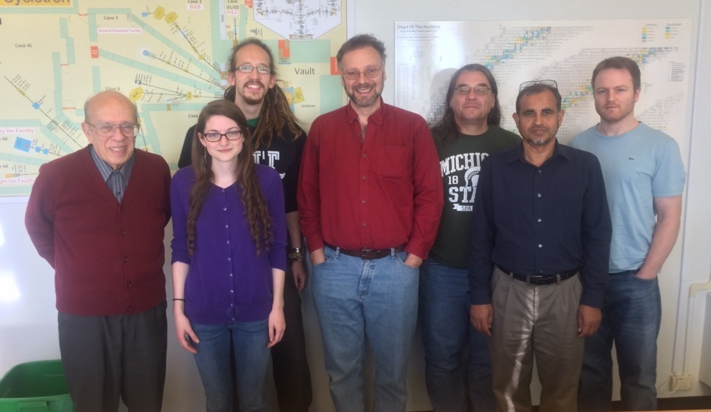
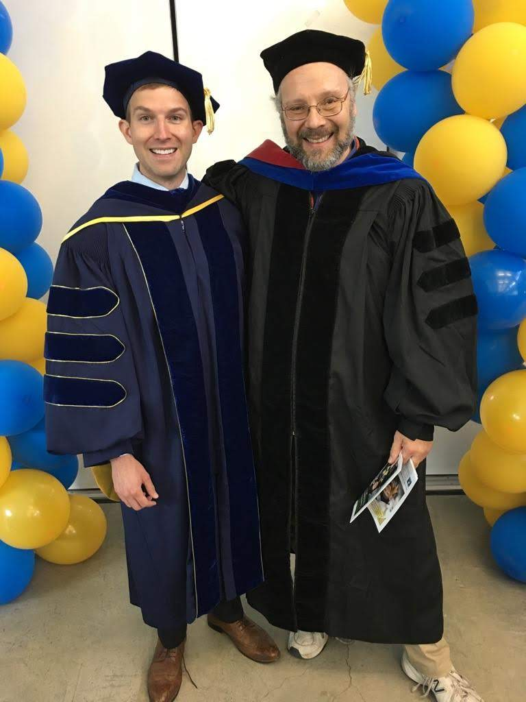

The LBNL/UCB Bay Area Nuclear Data (BAND) Group
E. Browne
A. Springer
J. Batchelder
A. Hurst
J. Morrell
E. Matthews
A. Voyles
A. Lewis
L. Bernstein
M. Basunia
Our goal is to address the data needs of the applied nuclear science community while training the next generation of nuclear scientists and engineers in the process
UCB Nuclear Engineering students lead our experimental program!
Notes:
We do this by bringing together young…and other…scientists and engineers

Slide 3
Cross-Section Measurements at the UC Berkeley HFNG
___________________________

Slide 4
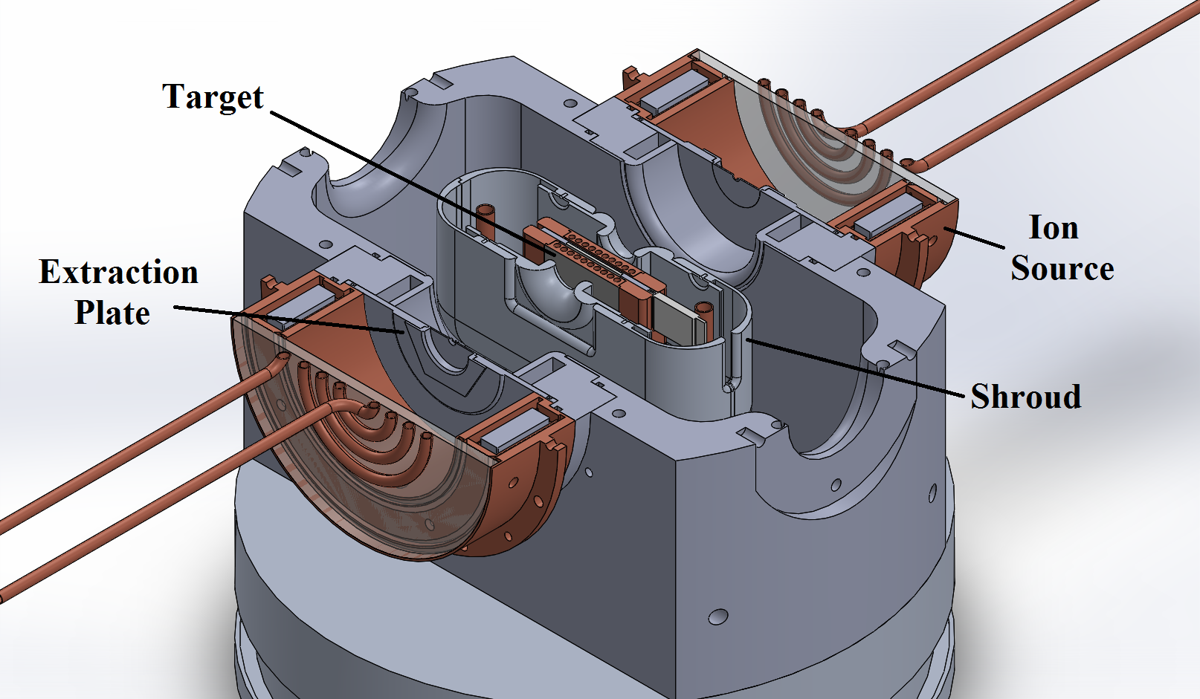

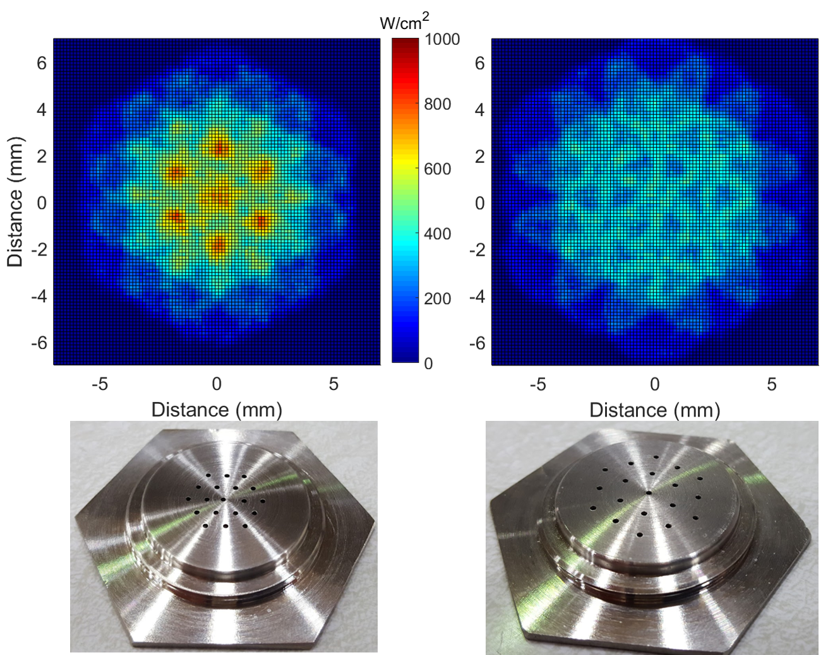
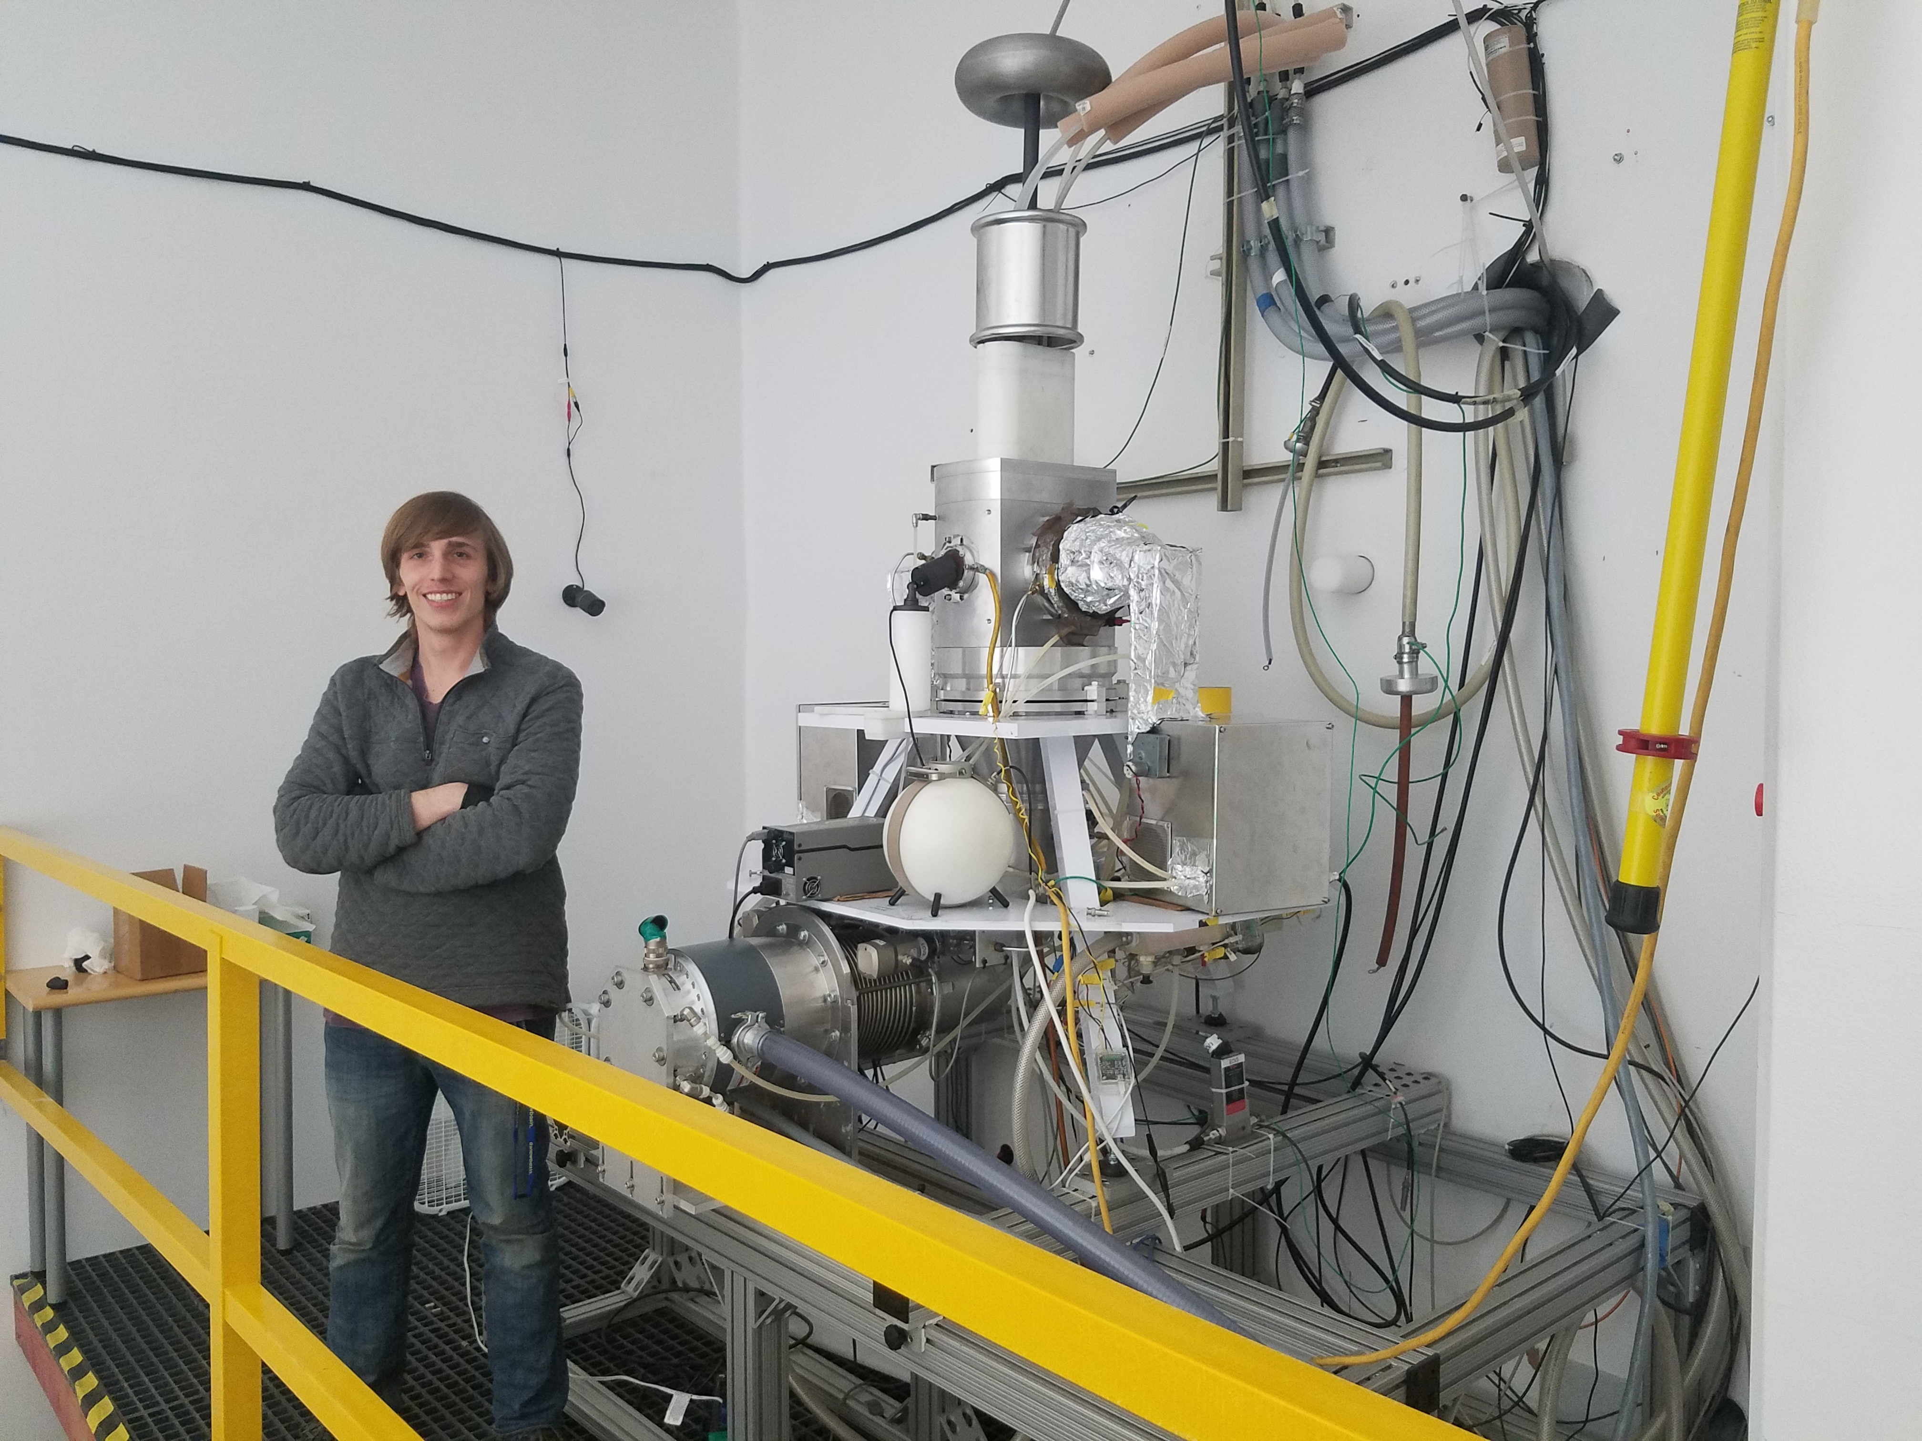
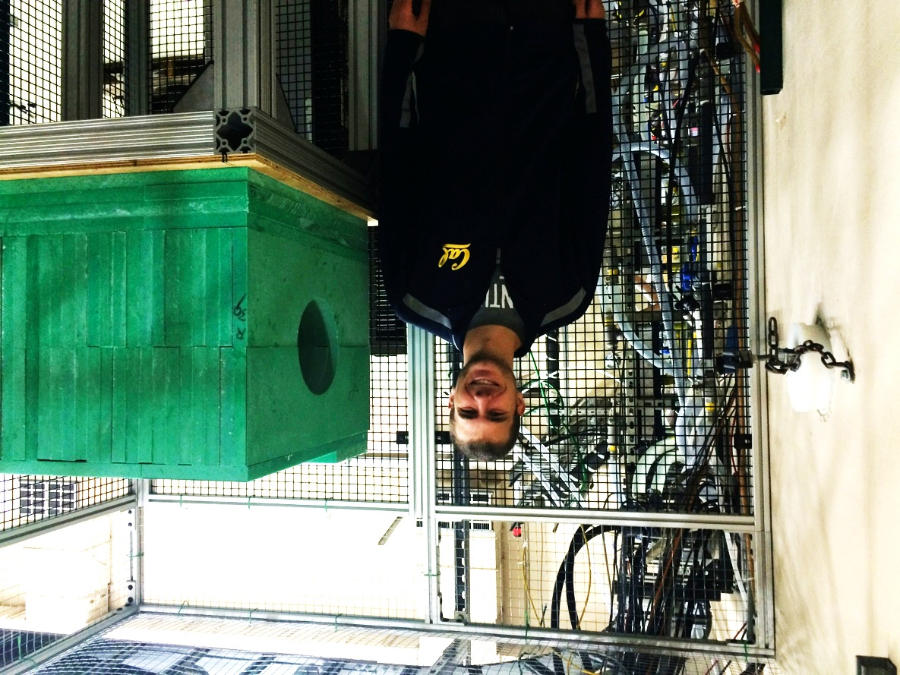

M. Allyon, “Design, construction, and characterization of a compact DD neutron generator designed for ⁴⁰Ar/³⁹Ar geochronology”, NIM A (Accepted, In Press, 2018)
3 generations of our “real neutron source”
M. Unzueta
C. Waltz
L. Kirsch
J. Morrell
Notes:
Advantages over thermal reactors:
Co-production of many unwanted activities via (n,γ)
Far cheaper startup costs, no proliferation concerns
Advantages over DT neutrons:
14-15 MeV DT neutrons open up unwanted (n,pxn) channels, contaminating the desired product
No tritium handling concerns
2-3 MeV DD neutrons are ideal for (n,p) and (n,α) production, but often suffer from fairly low flux, and poor nuclear data

Slide 5
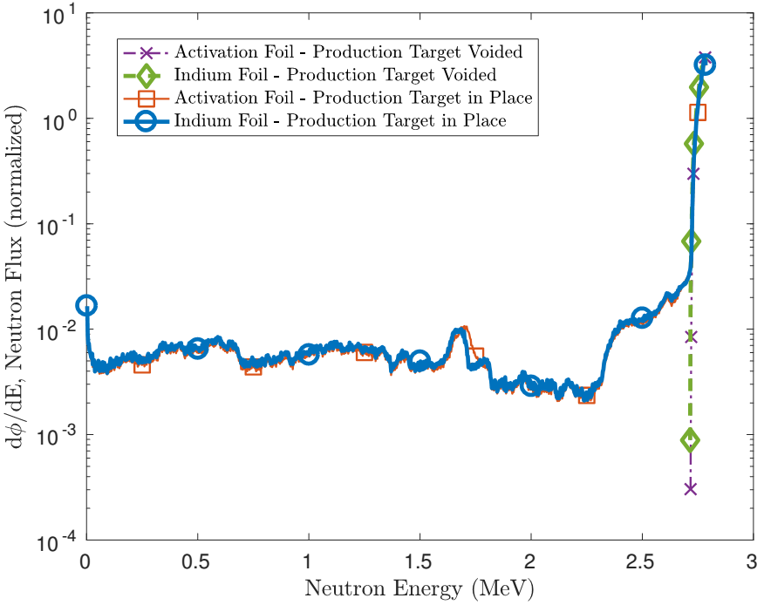
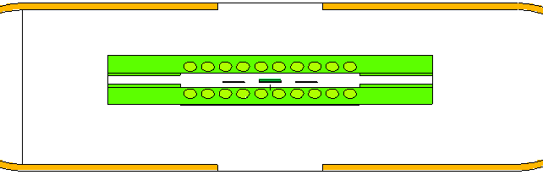
HFNG-Based Cross Section Measurements
Neutron flux profile modeled in target and monitor foil, using MCNP6
NDNCA Whitepaper available at http://bang.berkeley.edu/events/ndnca/whitepaper
S. Qaim called for measurements of (n,p) cross sections for the novel medical radionuclide production at NDNCA
Our paper introduces a neutron utilization parameter (η_{n}) which characterizes the effectiveness of a neutron generator as an isotope generator
³²S(n,p)³²P; ⁴⁷Ti(n,p)⁴⁷Sc, ⁶⁴Zn(n,p)⁶⁴Cu; ⁶⁷Zn(n,p)⁶⁷Cu; ⁸⁹Y(n,p)⁸⁹Sr; ¹⁰⁵Pd(n,p)¹⁰⁵Rh; ¹⁴⁹Sm(n,p)¹⁴⁹Pm, ¹⁵³Eu(n,p)¹⁵³Sm, ¹⁵⁹Tb(n,p)¹⁵⁹Gd; ¹⁶¹Dy(n,p)¹⁶¹Tb; ¹⁶⁶Er(n,p)¹⁶⁶Ho; ¹⁶⁹Tm(n,p)¹⁶⁹Er; ¹⁷⁵Lu(n,p)¹⁷⁵Yb; ¹⁷⁷Hf(n,p)¹⁷⁷Lu, and several others
[1] A.S. Voyles, NIM B 410 (2017), 230-239
Notes:
Advantages over thermal reactors:
Co-production of many unwanted activities via (n,γ)
Far cheaper startup costs, no proliferation concerns
Advantages over DT neutrons:
14-15 MeV DT neutrons open up unwanted (n,pxn) channels, contaminating the desired product
No tritium handling concerns
2-3 MeV DD neutrons are ideal for (n,p) and (n,α) production, but often suffer from fairly low flux, and poor nuclear data

Slide 6
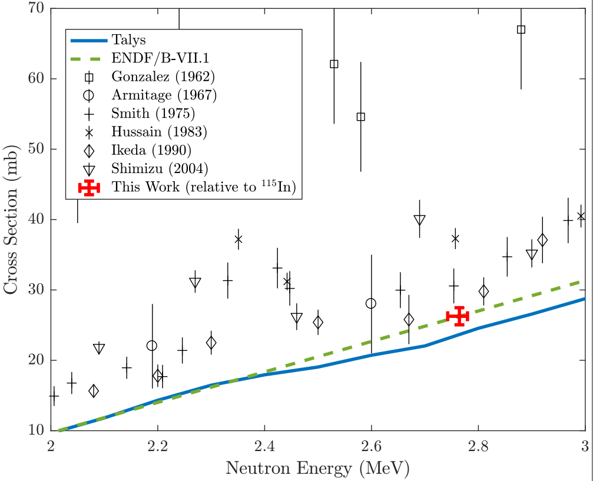
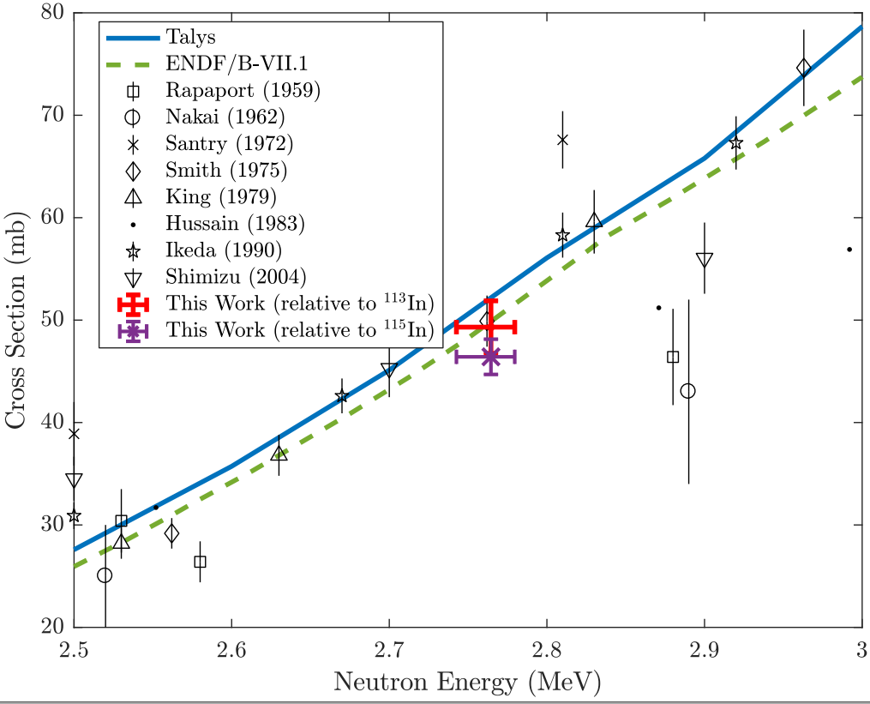
Medical Applications – (n,p) ⁶⁴Cu,⁴⁷Sc Production
⁶⁴Zn(n,p)⁶⁴Cu
Emerging medical radionuclides
⁶⁴Cu (t_{1/2} = 12.7 hr) – 61% β⁺ to ⁶⁴Ni, 39% β⁻ to ⁶⁴Zn
⁴⁷Sc (t_{1/2} = 3.35 d) – β⁻ to ⁴⁷Ti, with 159-keV γ
High-specific activity production
⁴⁷Ti(n,p)⁴⁷Sc
⁴⁷Ti(n,p)⁴⁷Sc
A.S. Voyles, “Measurement of the ⁶⁴Zn, ⁴⁷Ti(n,p) cross sections using a DD neutron generator for medical isotope studies”, NIM B 410 (2017) 230–239

Slide 7
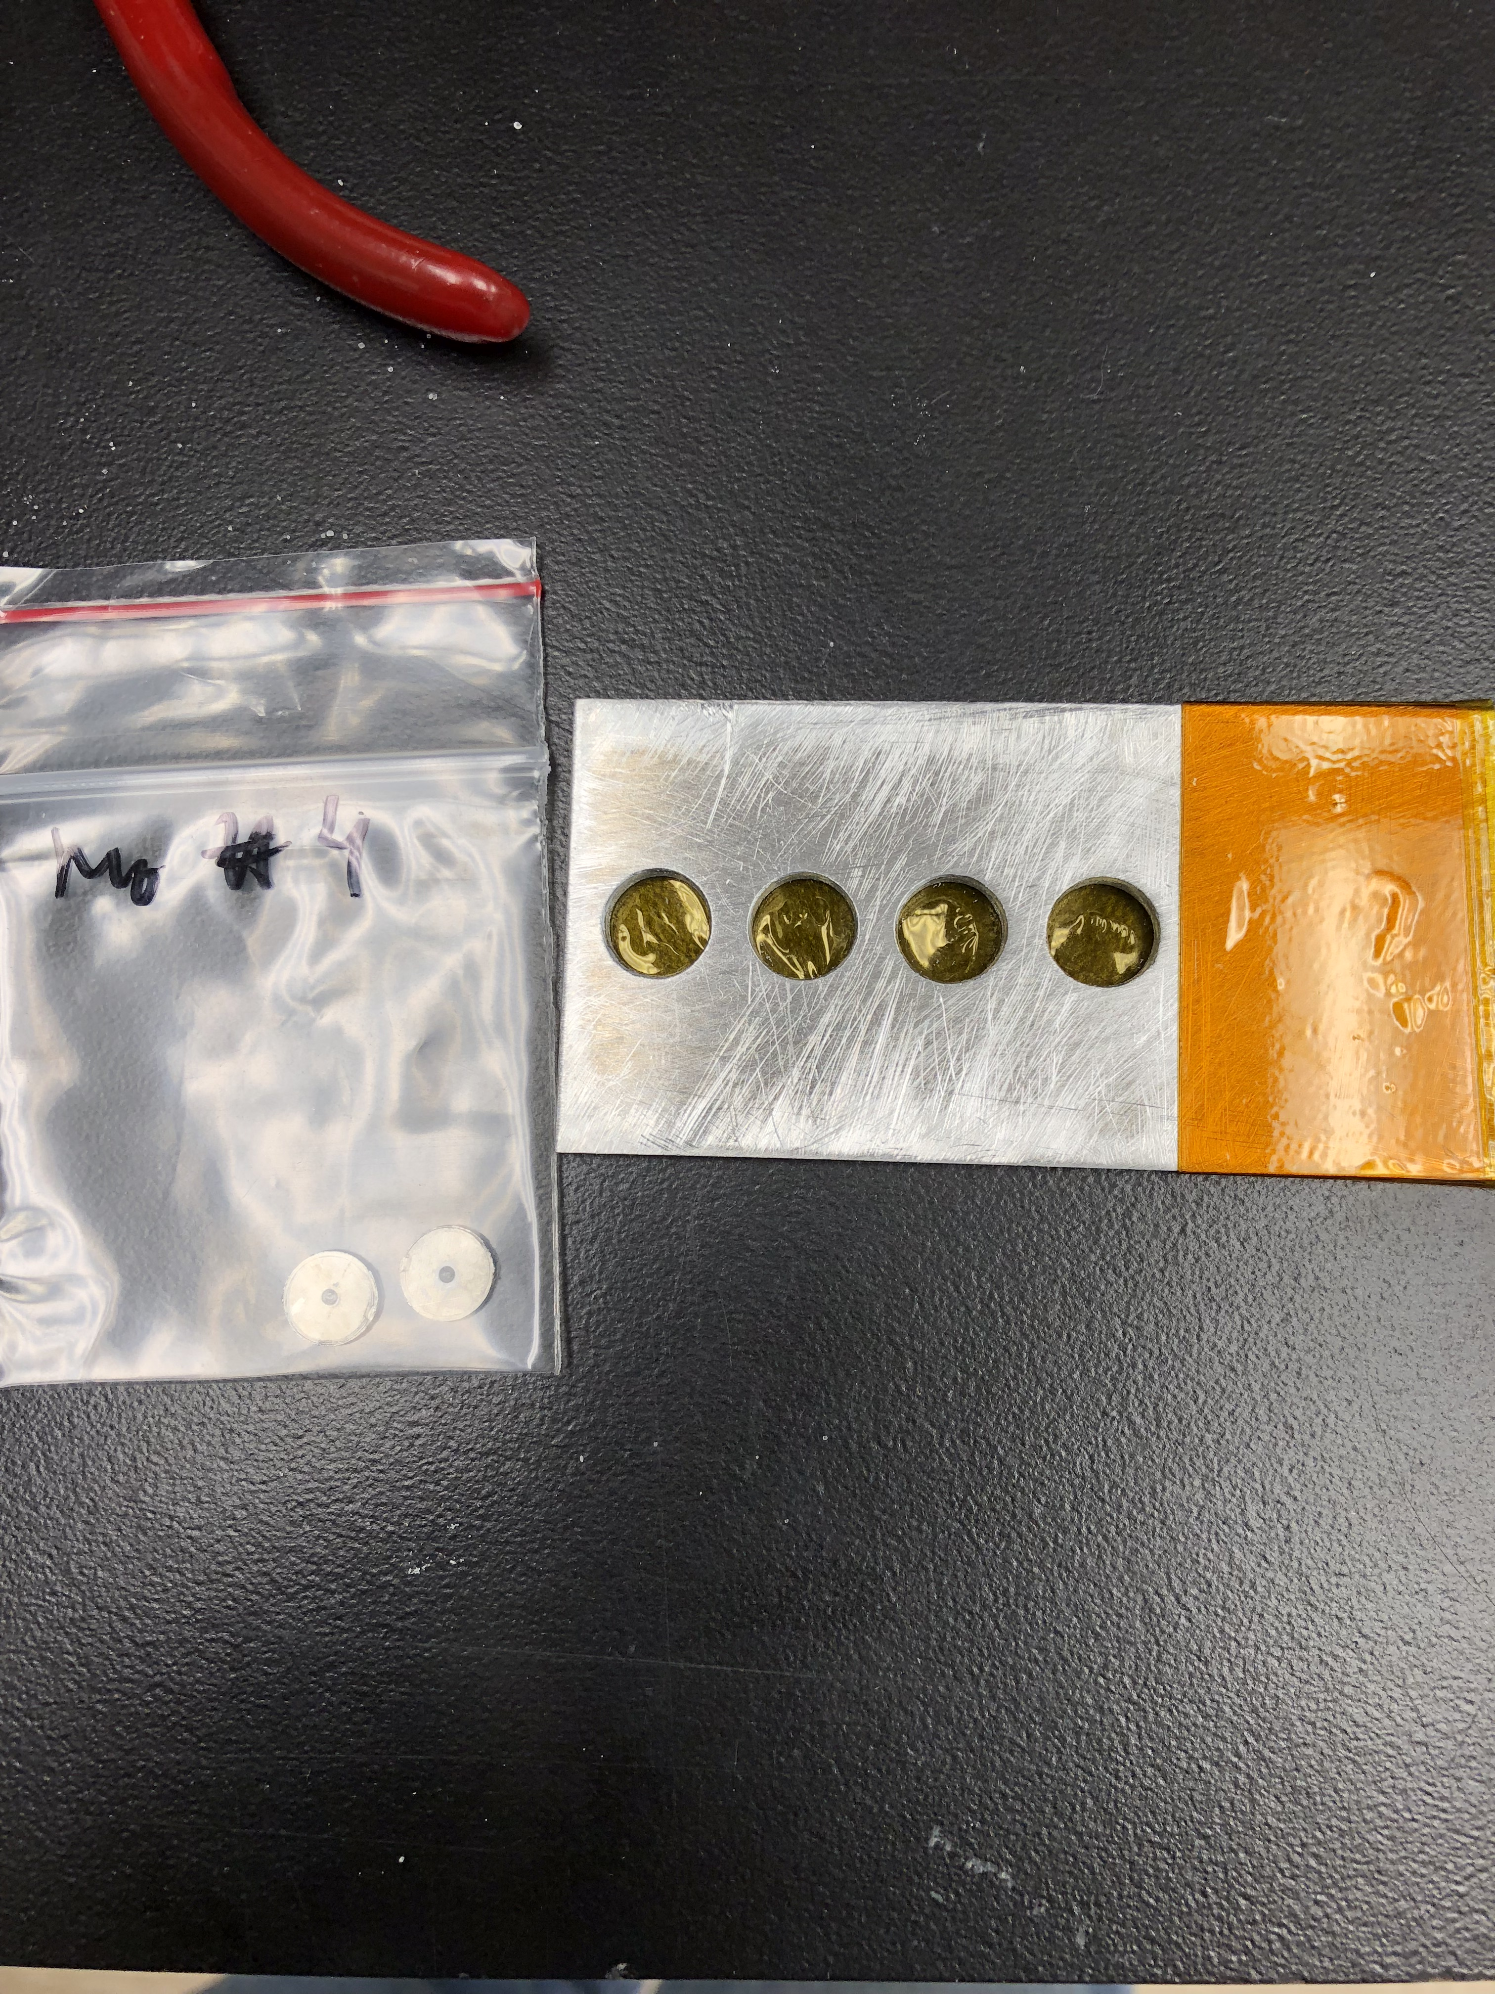
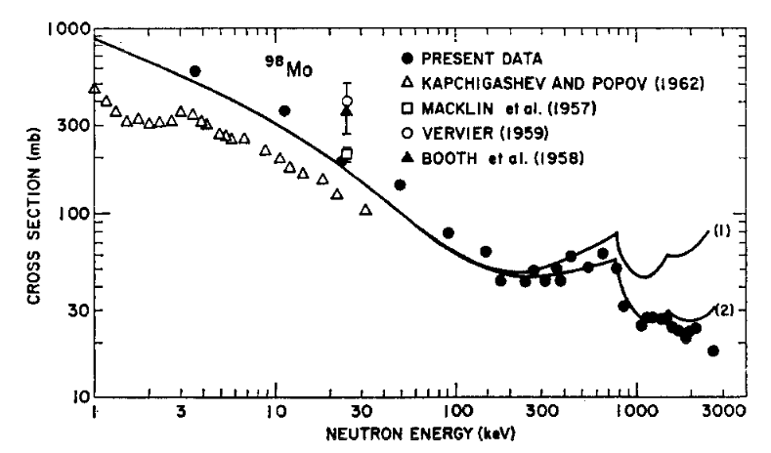
Measurement of the ⁹⁸Mo(n,γ) Cross Section
A recent experiment at the HFNG was conducted to re-measure the (n,γ) cross section of ⁹⁸Mo – first measurement since 1967!
Using a custom target holder, four energy locations were measured.
Re-measurement of this cross section in the 1-10 MeV was marked as a vital nuclear data need in the NDNCA nuclear data needs matrix, for thermal reactor ⁹⁹Mo production.
E. Matthews
Stupegia et al., 1967

Slide 8

Addressing large discrepancies between data libraries for ³⁵Cl(n,p) cross section
ENDF/B-VII.1 (and VIII) includes detailed calculated resonances between 0.1 MeV and 1.2 MeV The cross section in this region is 2-3 orders of magnitude smaller when using ENDF/B-VII.1 vs. ENDF/B-VII.0
Higher than 1.2 MeV, in all libraries, the cross-section is assumed to be in an Unresolved Resonance Region (URR)
In fast neutron systems most neutrons have energies > 100 keV. There are NO measurements between 100 keV and 14 MeV.
In order to decrease the uncertainties in the ³⁵Cl neutron capture, experiments were performed to measure the ³⁵Cl(n,p)³⁵S and the ³⁵Cl(n,a)³²P cross sections using the High Flux Neutron Generator (HFNG) on the University of California Berkeley campus.
J. Batchelder
S. Chong

Slide 9
³⁵Cl(n,x) Results
³⁵Cl(n,p)
³⁵Cl(n,α)
Results – pt. 2
³⁵Cl(n,p)³⁵S cross-section is much lower than the ENDF/B-VIII value!
Structure is observed in the ³⁵Cl(n,p) and ³¹P(n,p) reactions. Cannot treat the region as an unresolved resonance region!
E_{n} (MeV) σ(mb) ³⁵Cl(n,p) ³⁵S σ (mb) ³⁵Cl(n,α) ³²P
this work ENDF-VIII this work ENDF-VIII
2.755(21) 29.5(10) 183 4.54(15) 7.2
2.661(35) 45.7(35) 173 3.94(31) 6.0
2.608(22) 41.1(41) 172 4.00(40) 4.7
2.539(6) 22.3(31) 171 3.79(52) 3.7
2.425(17) 14.1(44) 156 1.32(41) 1.4
Poor Agreement
Good Agreement

Slide 10
Stacked-target Charged Particle Excitation Functions
___________________________
^{Low Energy – LBNL}
Notes:
Cyclotron
Many hospitals have small K~15 medical cyclotrons for PET tracer production
Leverage existing infrastructure
Explore higher energies for regional research cyclotrons, basic science
Linac
Commonly used for high-energy production (LANL – IPF)
Useful for anchoring to complementary low-energy measurements

Slide 11
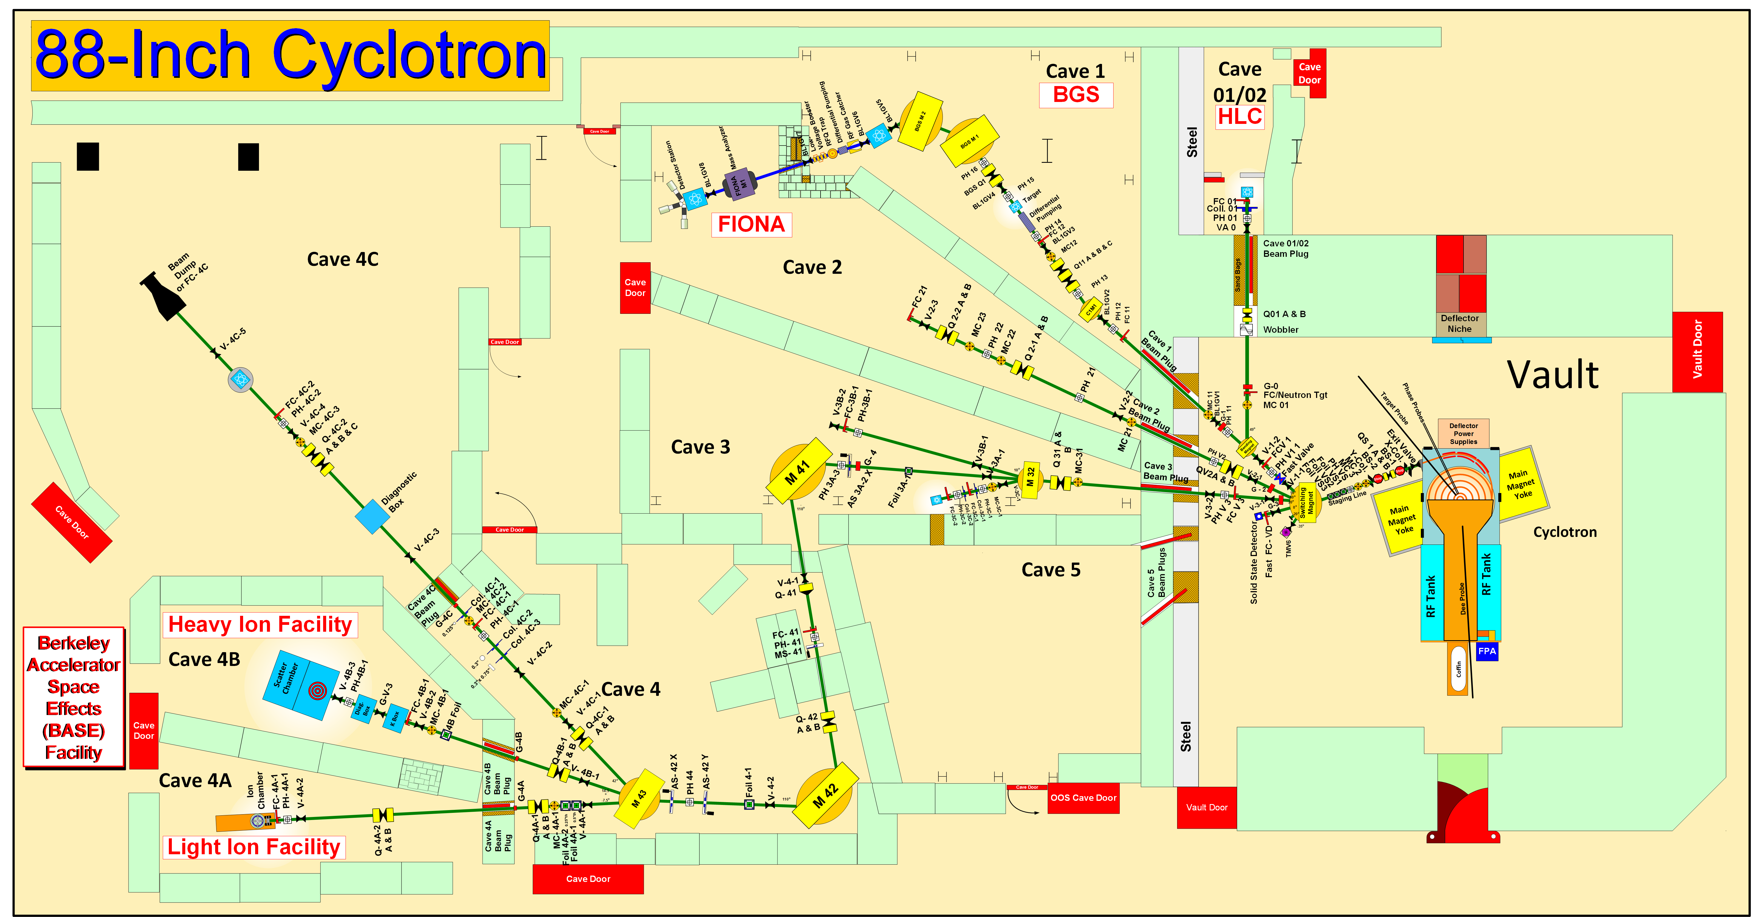
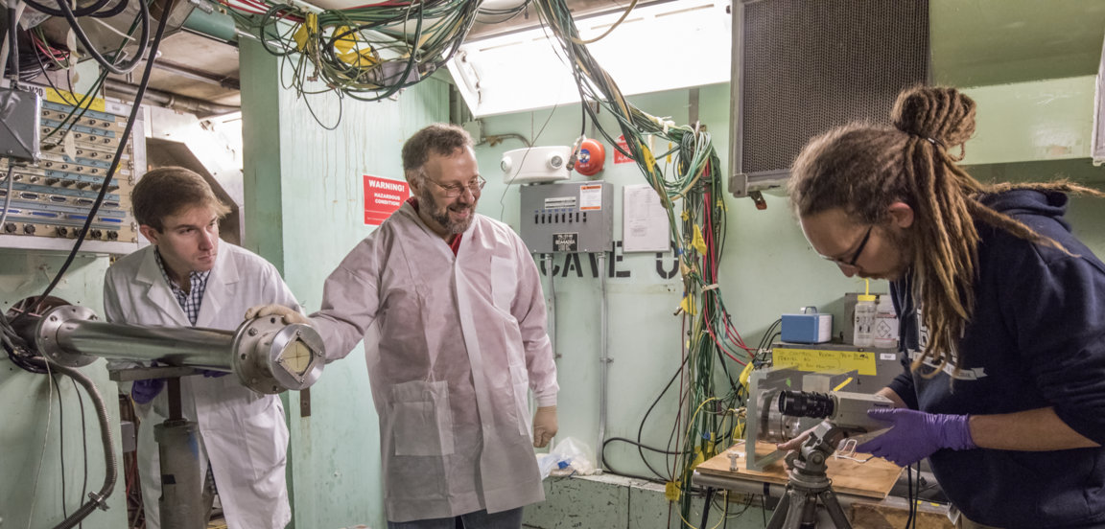
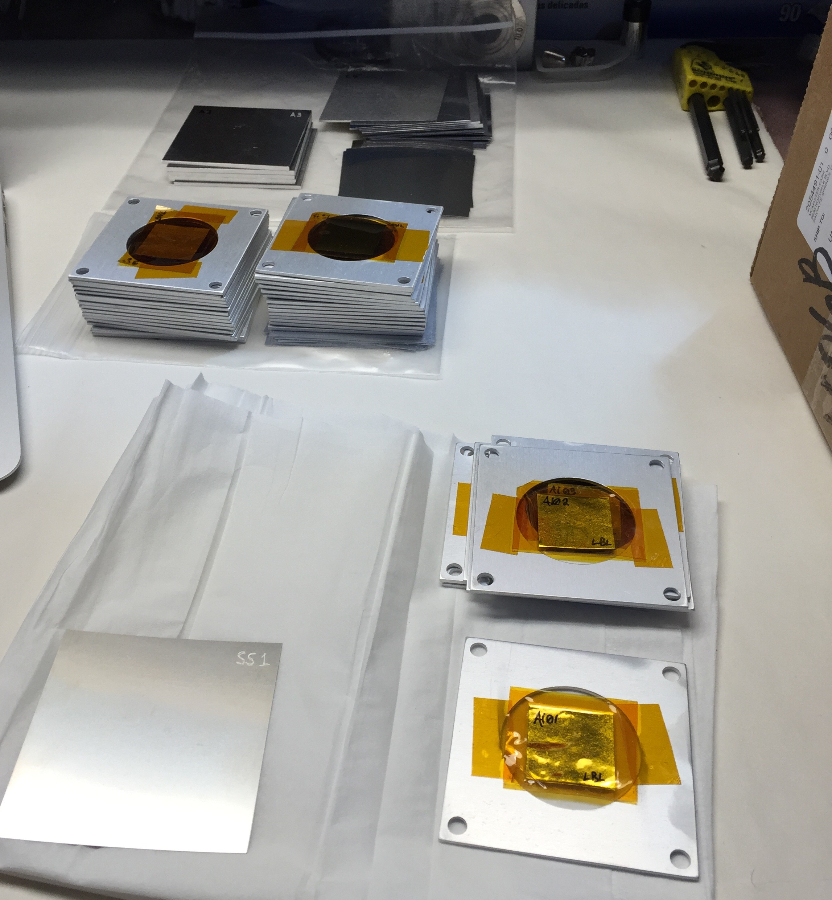
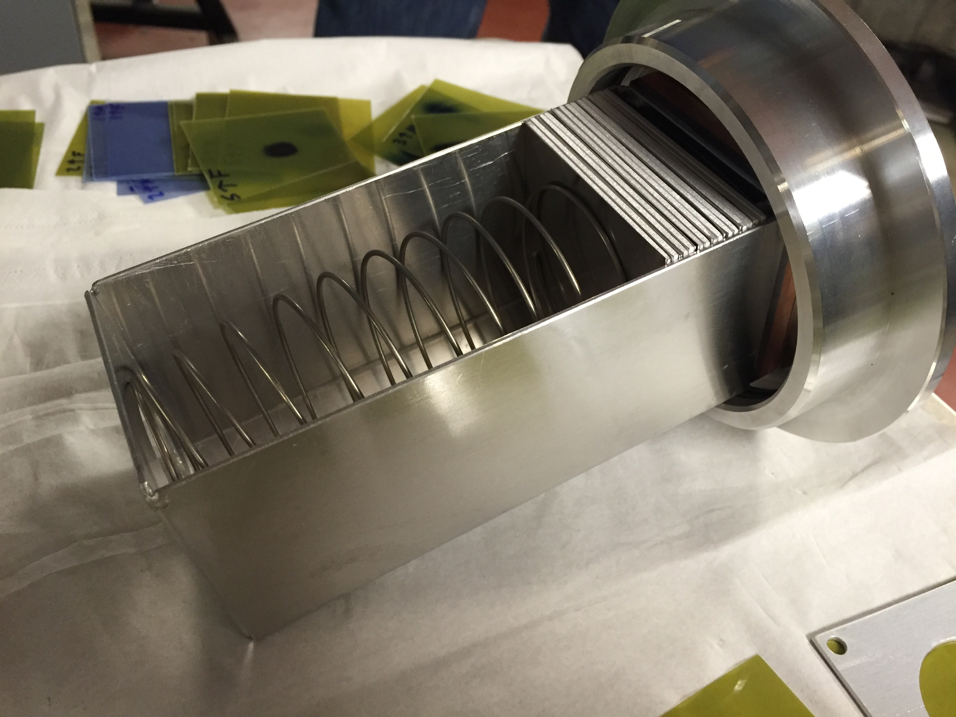
Stacked-target Charged Particle Excitation Functions
A. Springer
L. Bernstein
K-140
Two overlapping stacks: E_{p}= 55→21 MeV, 25→11 MeV (120 nA@10 min, 100 nA@20 min)
Notes:
Cyclotron freq w = Q B / m
T = (m/2) w^2 r^2
T/A = (B r / 2 m)^2 (Q/A)^2 = K (Q/A)^2

Slide 12
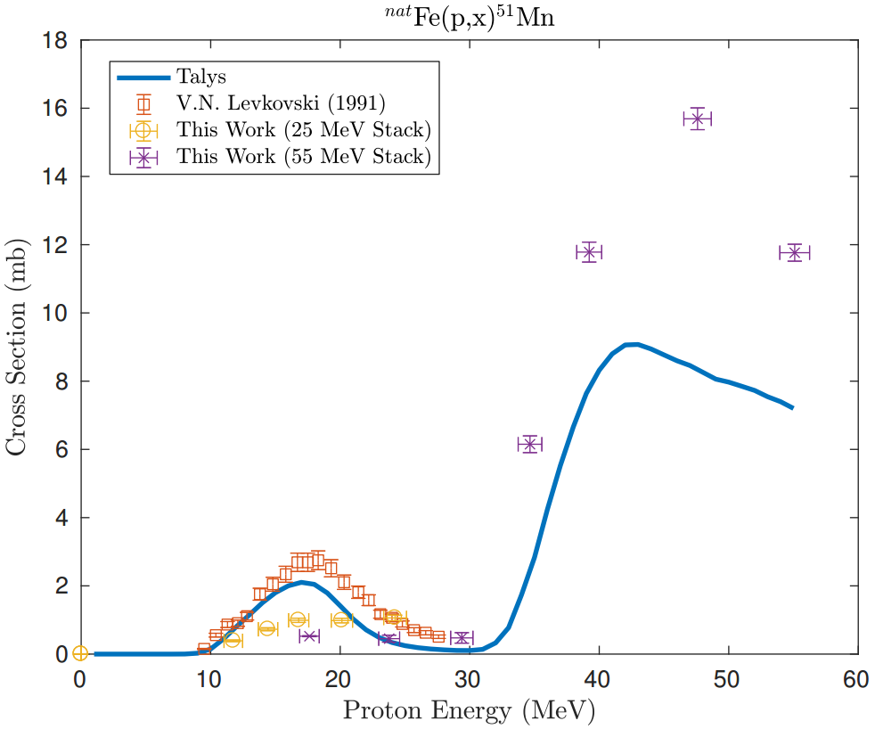
^{nat}Fe(p,x)^{51,52}Mn – Novel PET imaging
Emerging medical radionuclides
⁵¹Mn (t_{1/2} = 46 min, 97% β⁺) – short-lived PET tracer for metabolic studies
^{52g}Mn (t_{1/2} = 5.6 d, 29% β⁺) – long-lived PET tracer for neuron tracking, immune studies
Preliminary
Results consistent with R≈1 at high energy.
At low energy, results are ambiguous due to energy straggling.
Preliminary
Notes:
Discrepancy possible causes :
Still using current from charge integrator, once energy assignment is finished, monitor foils will provide renormalization to true current
Direct production of 51Cr creates “extra” cross section
Low peak is 54Fe(p,x), high peak is 56Fe(p,x)

Slide 13
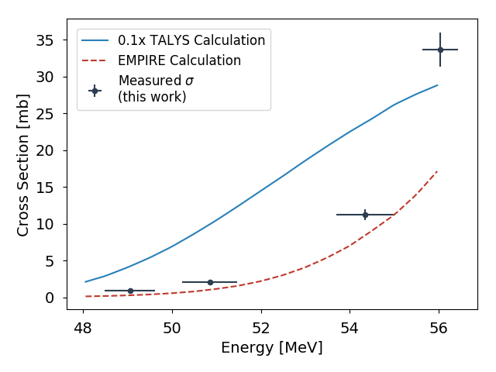
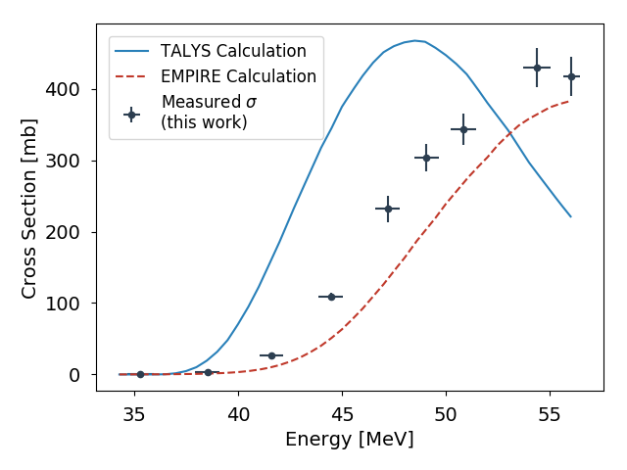
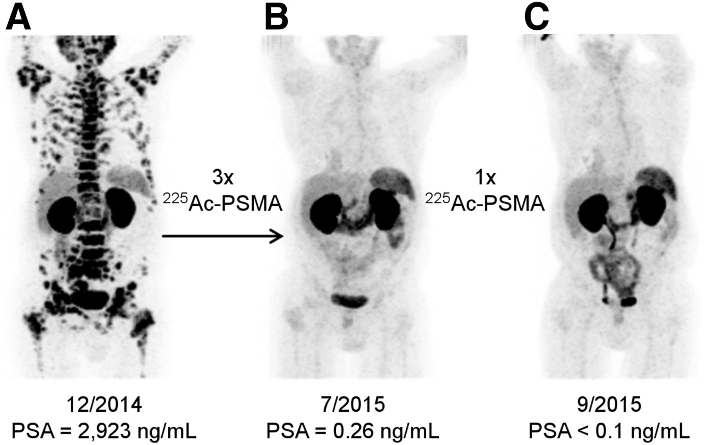
¹⁴⁰La(p,6n)¹³⁴Ce - a PET analogue for ²²⁵Ac
Go see the poster!
¹⁴⁰La(p,6n)¹³⁴Ce Cross Section
¹⁴⁰La(p,5n)¹³⁵Ce Cross Section
Preliminary
Preliminary
Jon Morrell
¹³⁵Ce is a contaminant isotope: higher-energy beam required for clean production of ¹³⁴Ce
Investigating potential for ²²⁶Ra(n,2n)²²⁵Ra → ²²⁵Ac
Kratochwil, Clemens, et al. "225Ac-PSMA-617 for PSMA-targeted α-radiation therapy of metastatic castration-resistant prostate cancer." Journal of Nuclear Medicine 57.12 (2016): 1941-1944.
Notes:
3x 9 MBq dose fractions
Useful for bio-kinetic studies of monoclonal antibodies (the delivery agent)
Interesting nuclear physics relevance: pre-equilibrium modelling, isomer/ground state ratios
No previous measurements, only comparison to models
Surprising results: TALYS 10x over-prediction of XS

Slide 14
Stacked-target Charged Particle Excitation Functions
___________________________
^{Intermediate Energy – LANL}

Slide 15
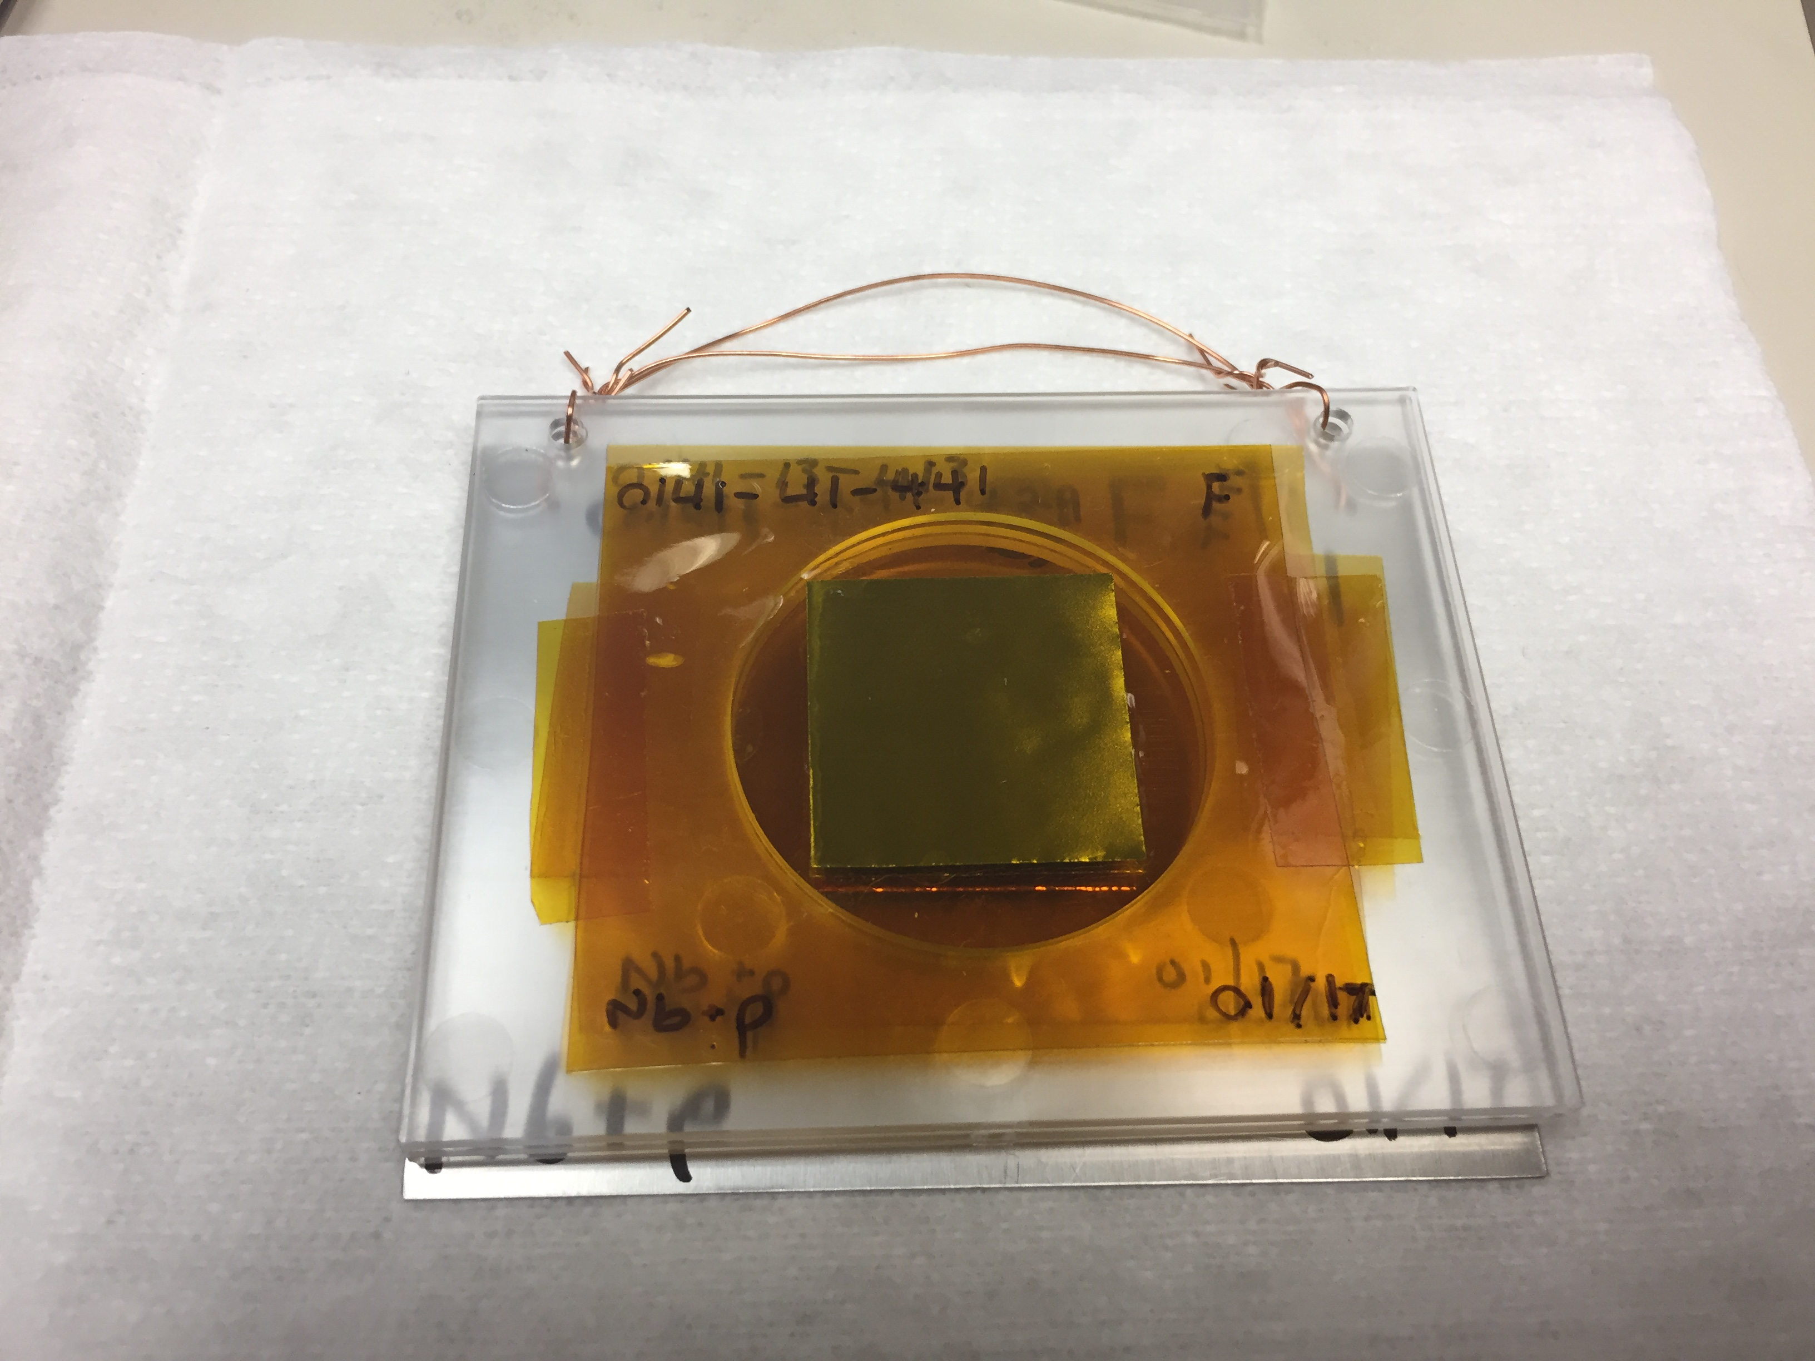
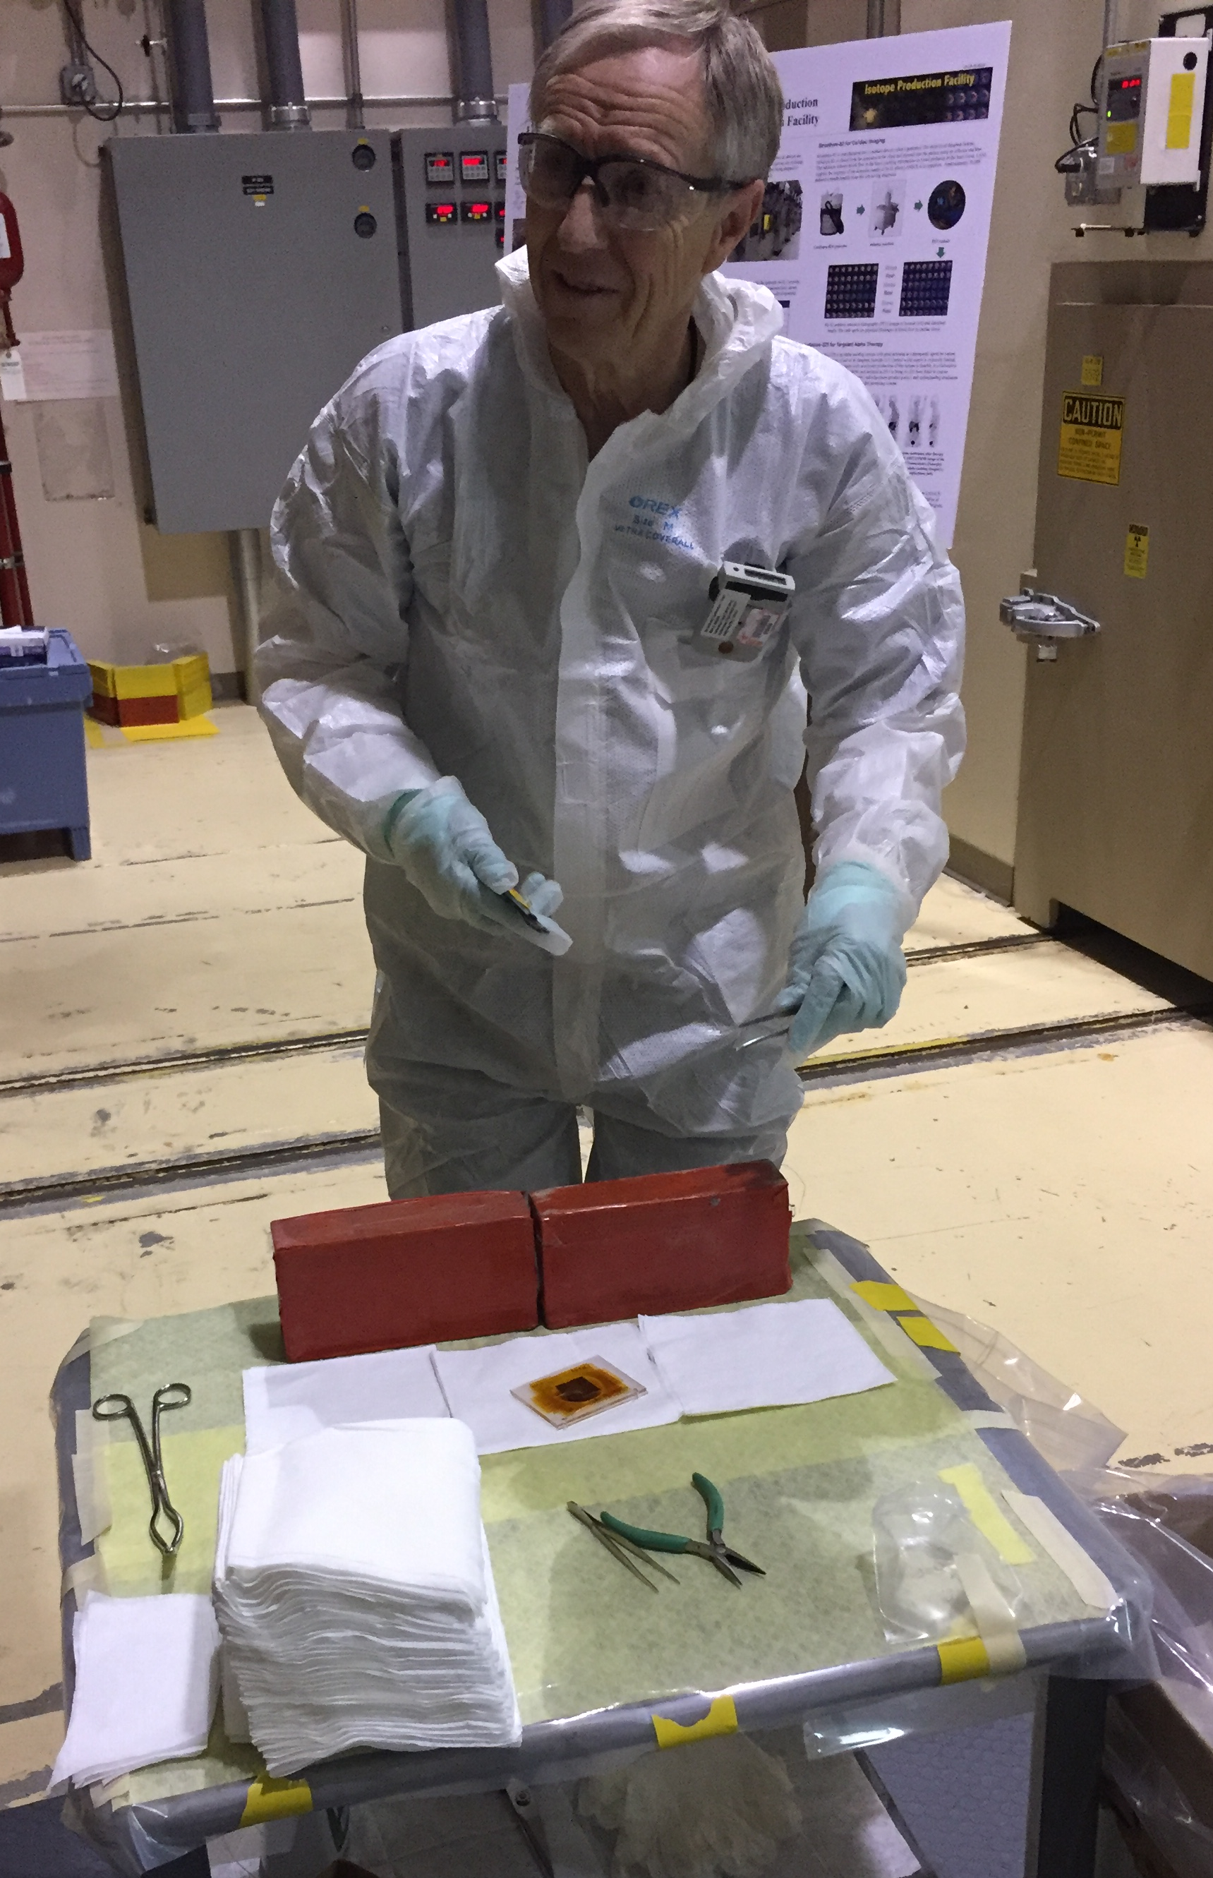
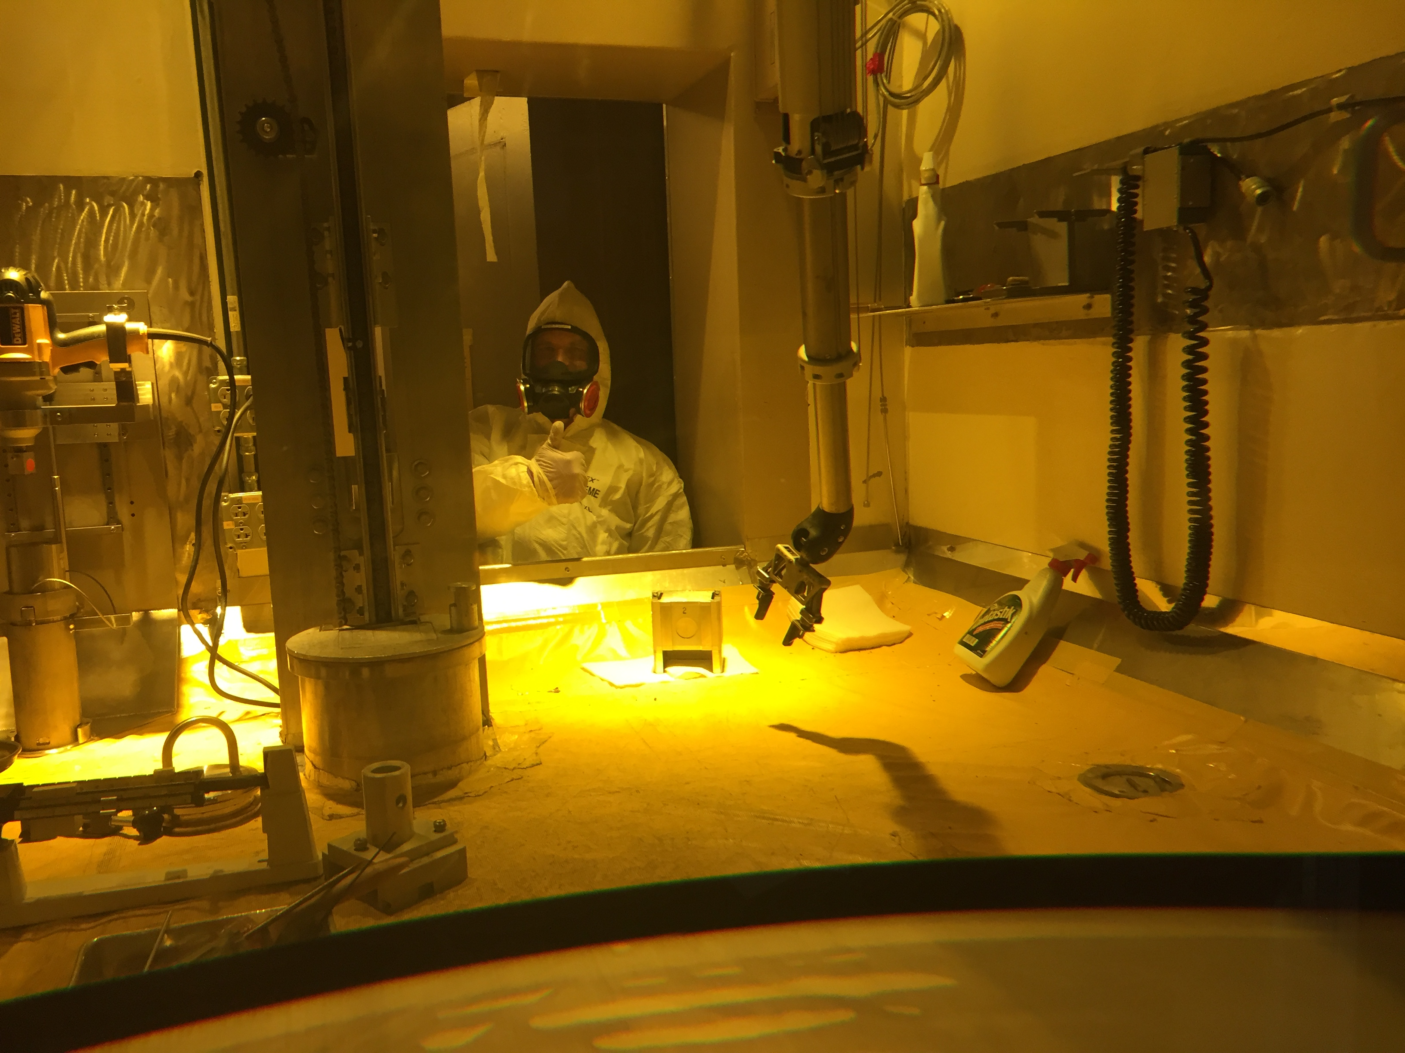
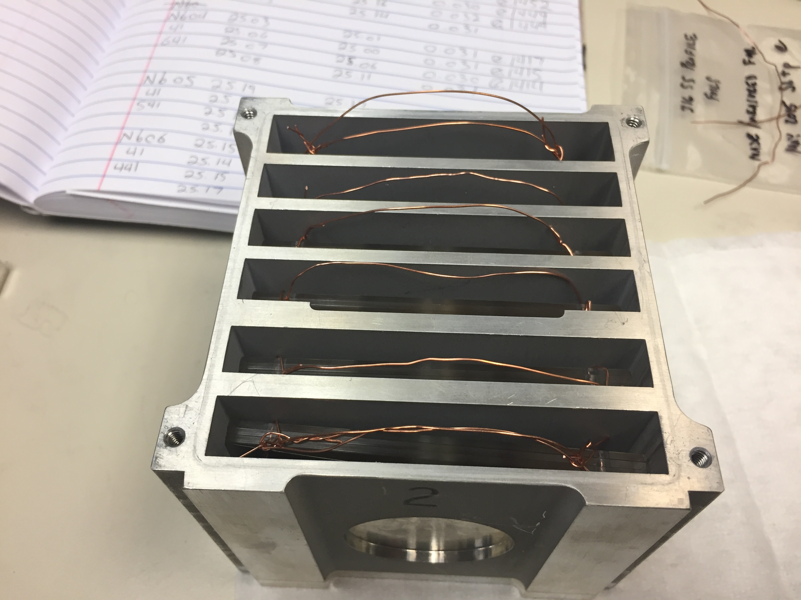
Measurements @ LANL – Nb(p,x)
^{nat}Nb(p,4n)⁹⁰Mo is a high-priority objective as a new proton beam dosimetry standard for E_{p} ≈ 40 – 200 MeV
Other emerging radionuclides: ^{82m}Rb, ⁸⁶Y, ⁸⁹Zr, ⁹⁰Nb
M. Nortier
^{100 MeV p+}
^{100 nA @ 3 hr}

Slide 16
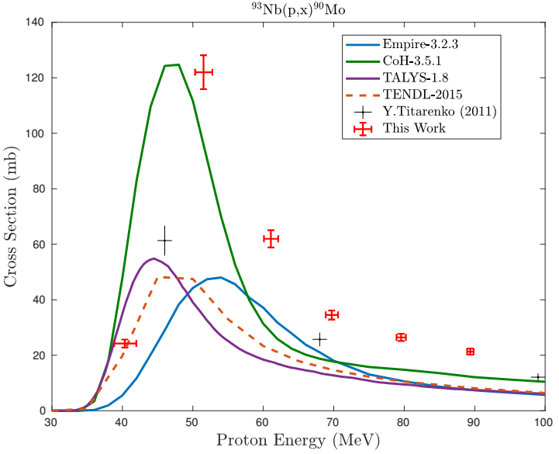
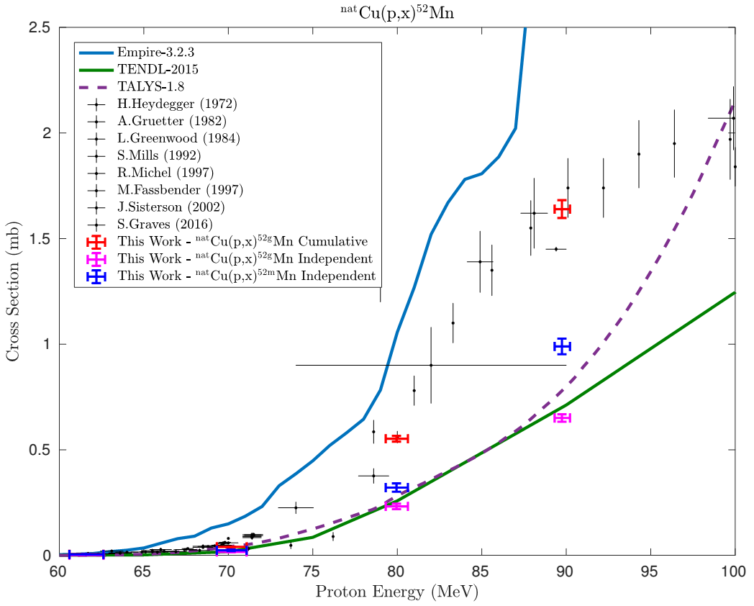
Measurements @ LANL – Nb(p,x)
Measurements of 38 cross-sections for ⁹³Nb(p,x) and ^{nat}Cu(p,x)
ε+β⁺ |  |  | ⁹⁰Mo |  |  | ^{93m}Mo | ⁹⁴Mo
IT |  |  | ^{89m}Nb ⁸⁹Nb | ⁹⁰Nb | ^{91m}Nb | ^{92m}Nb | ⁹³Nb
 | ⁸⁶Zr | ⁸⁷Zr | ⁸⁸Zr | ⁸⁹Zr
 | ^{85m}Y ⁸⁵Y | ⁸⁶Y | ^{87m}Y ⁸⁷Y | ⁸⁸Y
⁸³Sr |  | ^{85m}Sr
^{82m}Rb |  |  |  |  |  |  |  | β⁻
^{100 MeV p+}
A.S. Voyles et al., “Excitation functions for (p,x) reactions of niobium in the energy range of E_{p} = 40–90 MeV”, NIM B (Accepted, In Press, 2018)

Slide 17
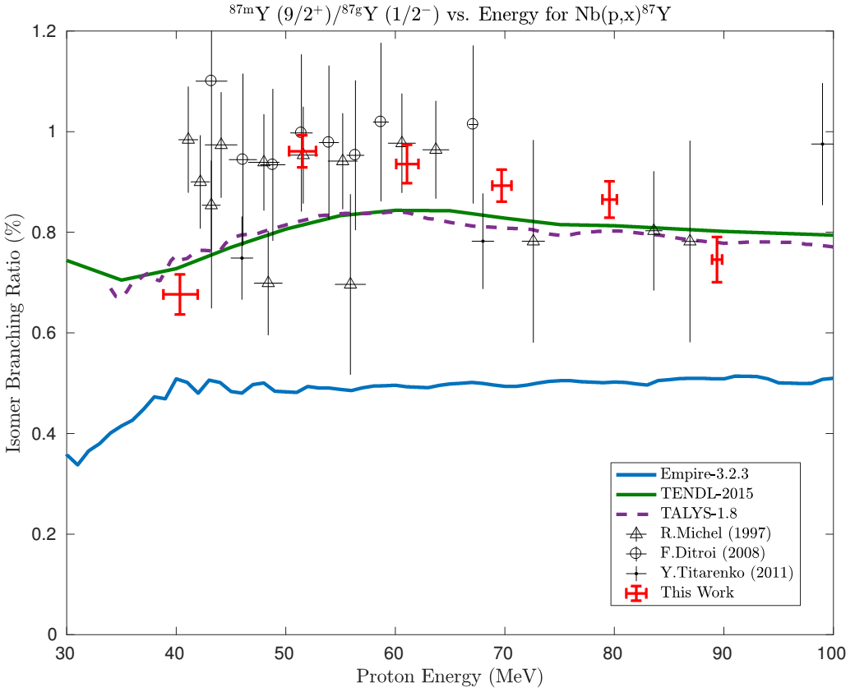

Measurements @ LANL – Nb(p,x)
5 independent measurements of isomer-to-ground state ratios
A. Lewis
[1] A.S. Voyles, NIM B (2018)

Slide 18
Alternative (n,x) Production Capabilities at the 88-Inch Cyclotron
___________________________

Slide 19
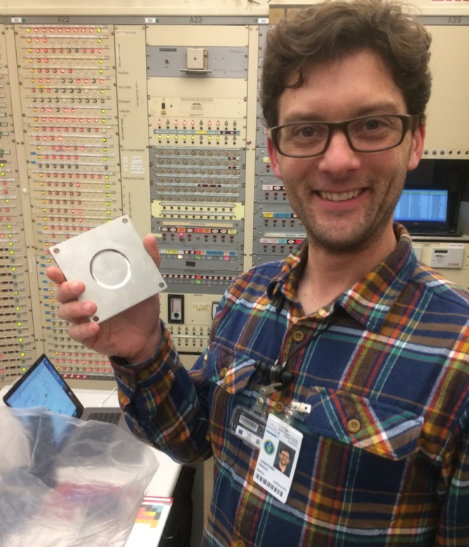
⁷Li(p,n) “Quasi-Monoenergetic” Neutron Source
Vault-based irradiation
Inconel-clad Li targets
(LANL LDRD)
Unreacted protons
0°
-20°
Li(p,n) neutron
production target
Jon Engle
Neutrons from 0-60 MeV
Y, Co, Al, In, Zr, Au samples irradiated in the vault
Unreacted beam dumped in Cave 0
Flux from 10⁶⁻⁴ /MeV/sr/s (decreases w/E_{n})
First experiments took place in April 2018
Notes:
This is the same method used at the new FRANZ facility in Frankfurt.

Slide 20
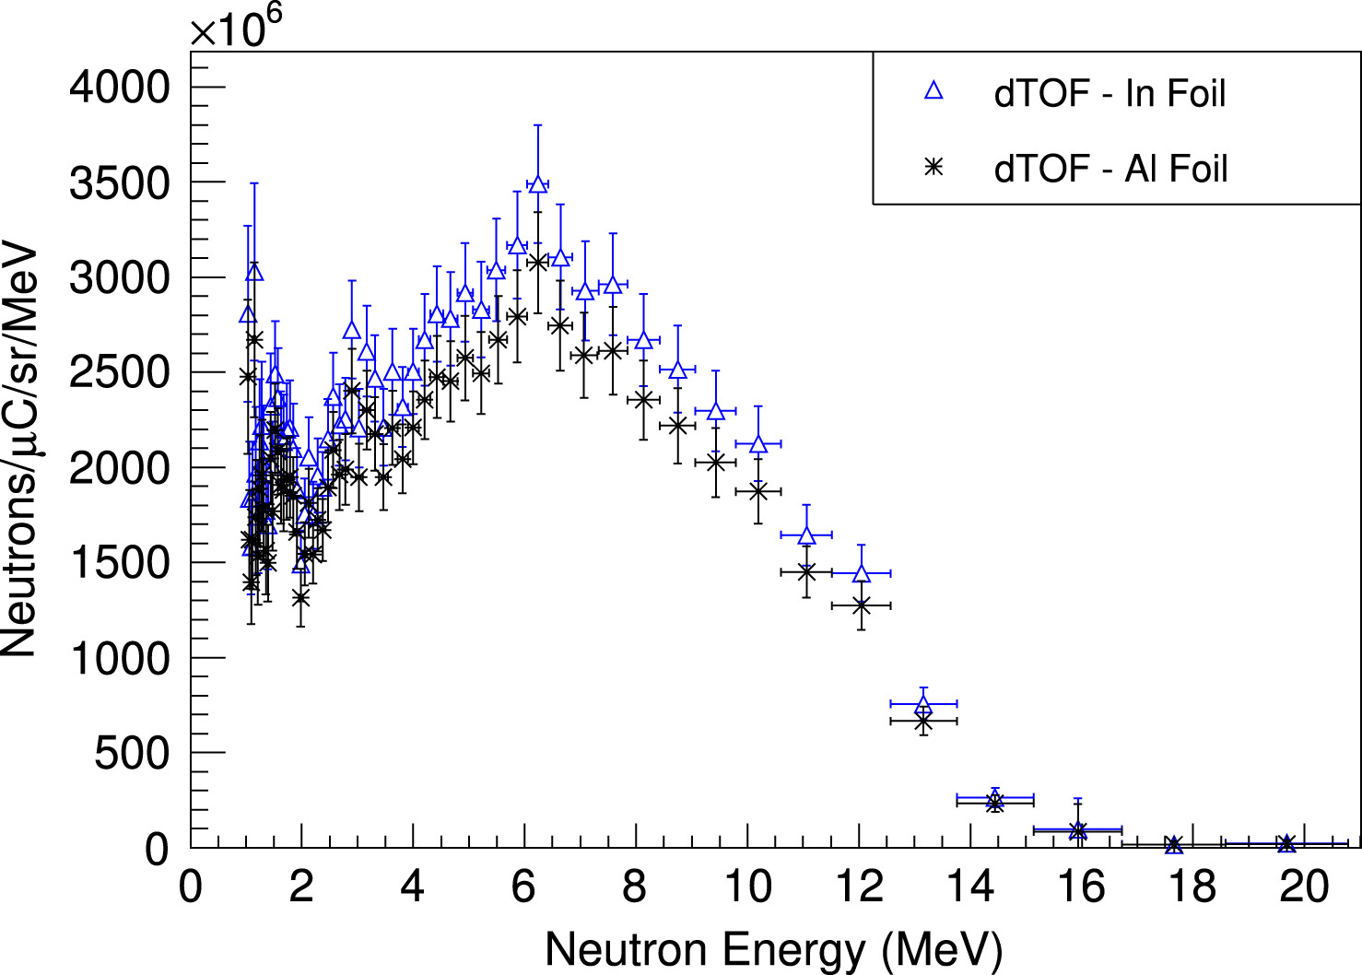
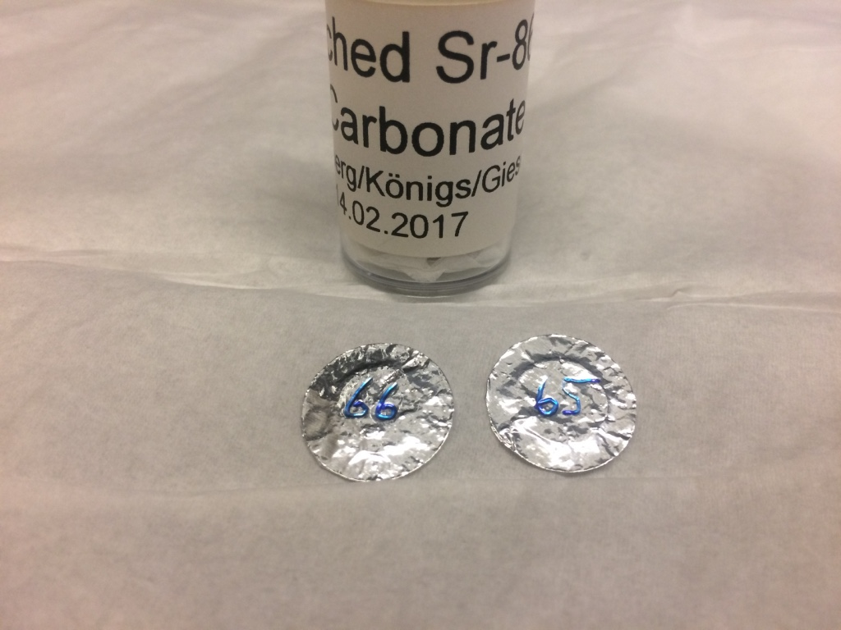
Simultaneous Radionuclide Production
≤ 50 MeV deuterons
(d,xn) target
Unreacted deuterons
Thick Be breakup target
Energetic secondary neutrons
(n,p) and/or (n,2n) target
(d,xn) reaction produces the same radionuclide as the commonly-used (p,n) reaction
Simultaneously makes a significant energetic secondary neutron flux (ESNF) from breakup of unreacted primary deuteron beam.
ESNF can be used to produce high specific-activity radionuclides via (n,2n), or charge exchange reactions such as (n,p) and (n,α).
⁸⁶Sr(d,2n)^{86m,g}Y w/ ²²⁶Ra(n,2n)²²⁵Ra→ ²²⁵Ac planned for Fall 2018!
[1] K. P. Harrig, et al., “Neutron Spectroscopy for pulsed beams with frame overlap using a double time-of-flight technique,” NIM A, 877, pp. 359–366, 2018.

Slide 21
¹⁵⁵Gd(n,2n) Surrogate Cross-Section Measurement
___________________________

Slide 22
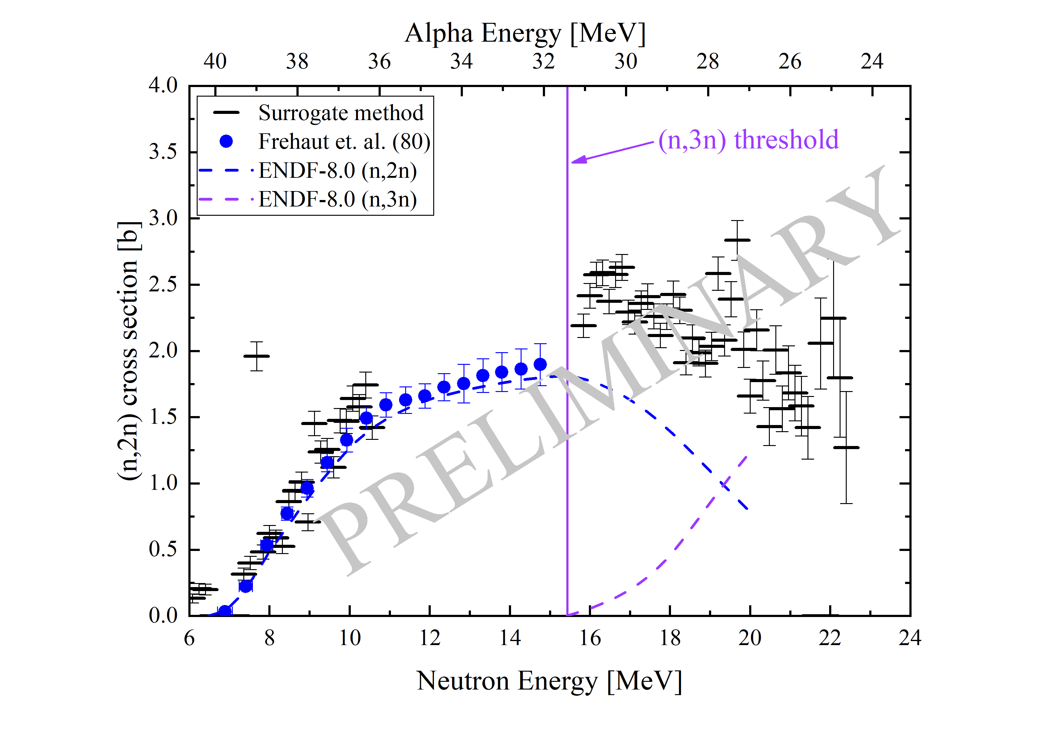
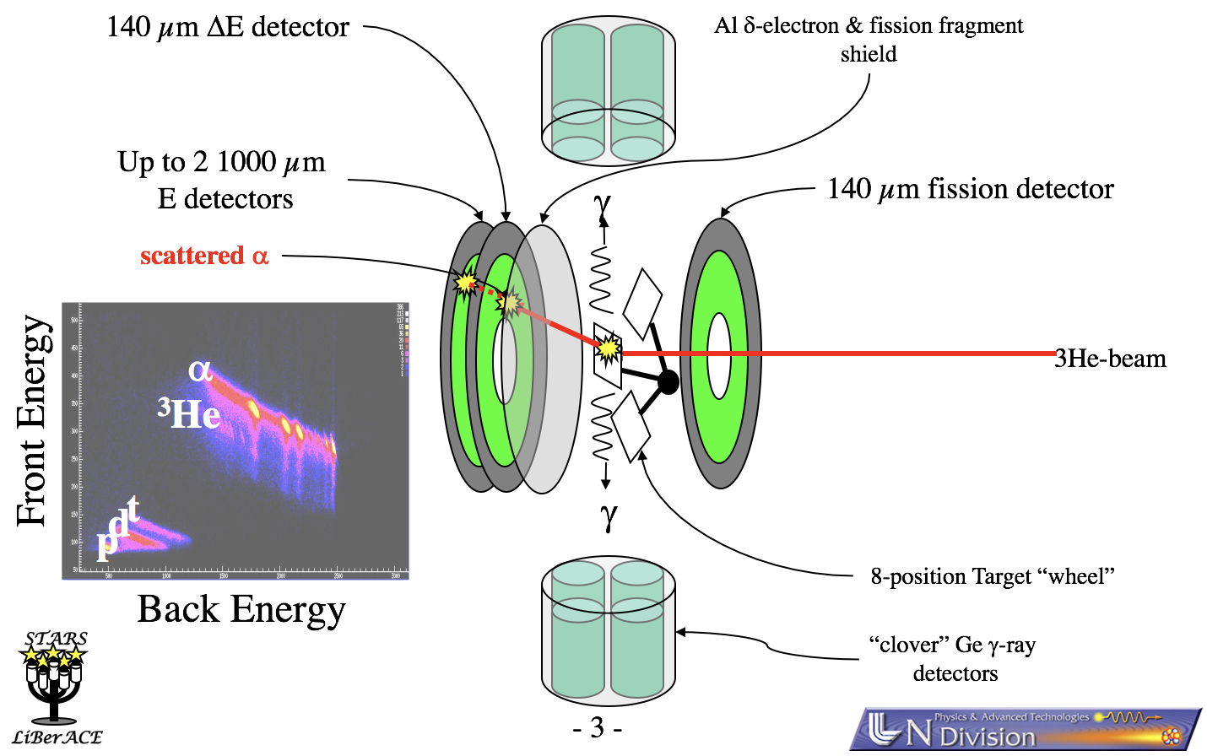
¹⁵⁵Gd(n,2n) cross section by measurement of surrogate reaction ¹⁵⁷Gd(³He,α2n)¹⁵⁴Gd
The LiBerACE detector setup was used with ΔE/E detectors for the alphas and clover detectors for the gammas
123 keV and 815 keV gamma lines were used to calculate a cross section for ¹⁵⁵Gd(n,2n)
Work is currently being done to re-analyze the gamma data
Darren Bleuel, 10/27/06 APS/DNP Meeting presentation
Notes:
157Gd(3He,alpha) reaction used to produce excited 156Gd. Alphas used as trigger, so alpha efficiency already accounted for.
Looked for the products 156Gd (indicating capture) and 154Gd (indicating 2n) by the gammas
Initially looking for capture surrogate, but that didn’t work out, but never looked at 154Gd data for (n,2n) surrogate
There was contamination in the alpha spectrum from (3He, alpha) reactions on the carbon and oxygen isotopes that are ever present. Using just the parts of the spectrum that don’t seem contaminated, have the black data points up there

Slide 23
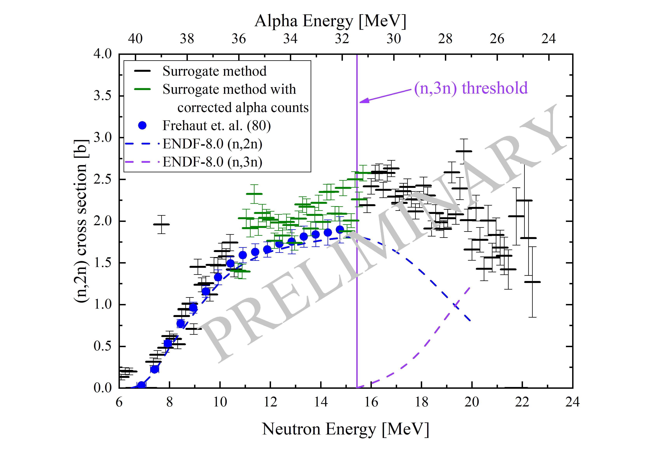
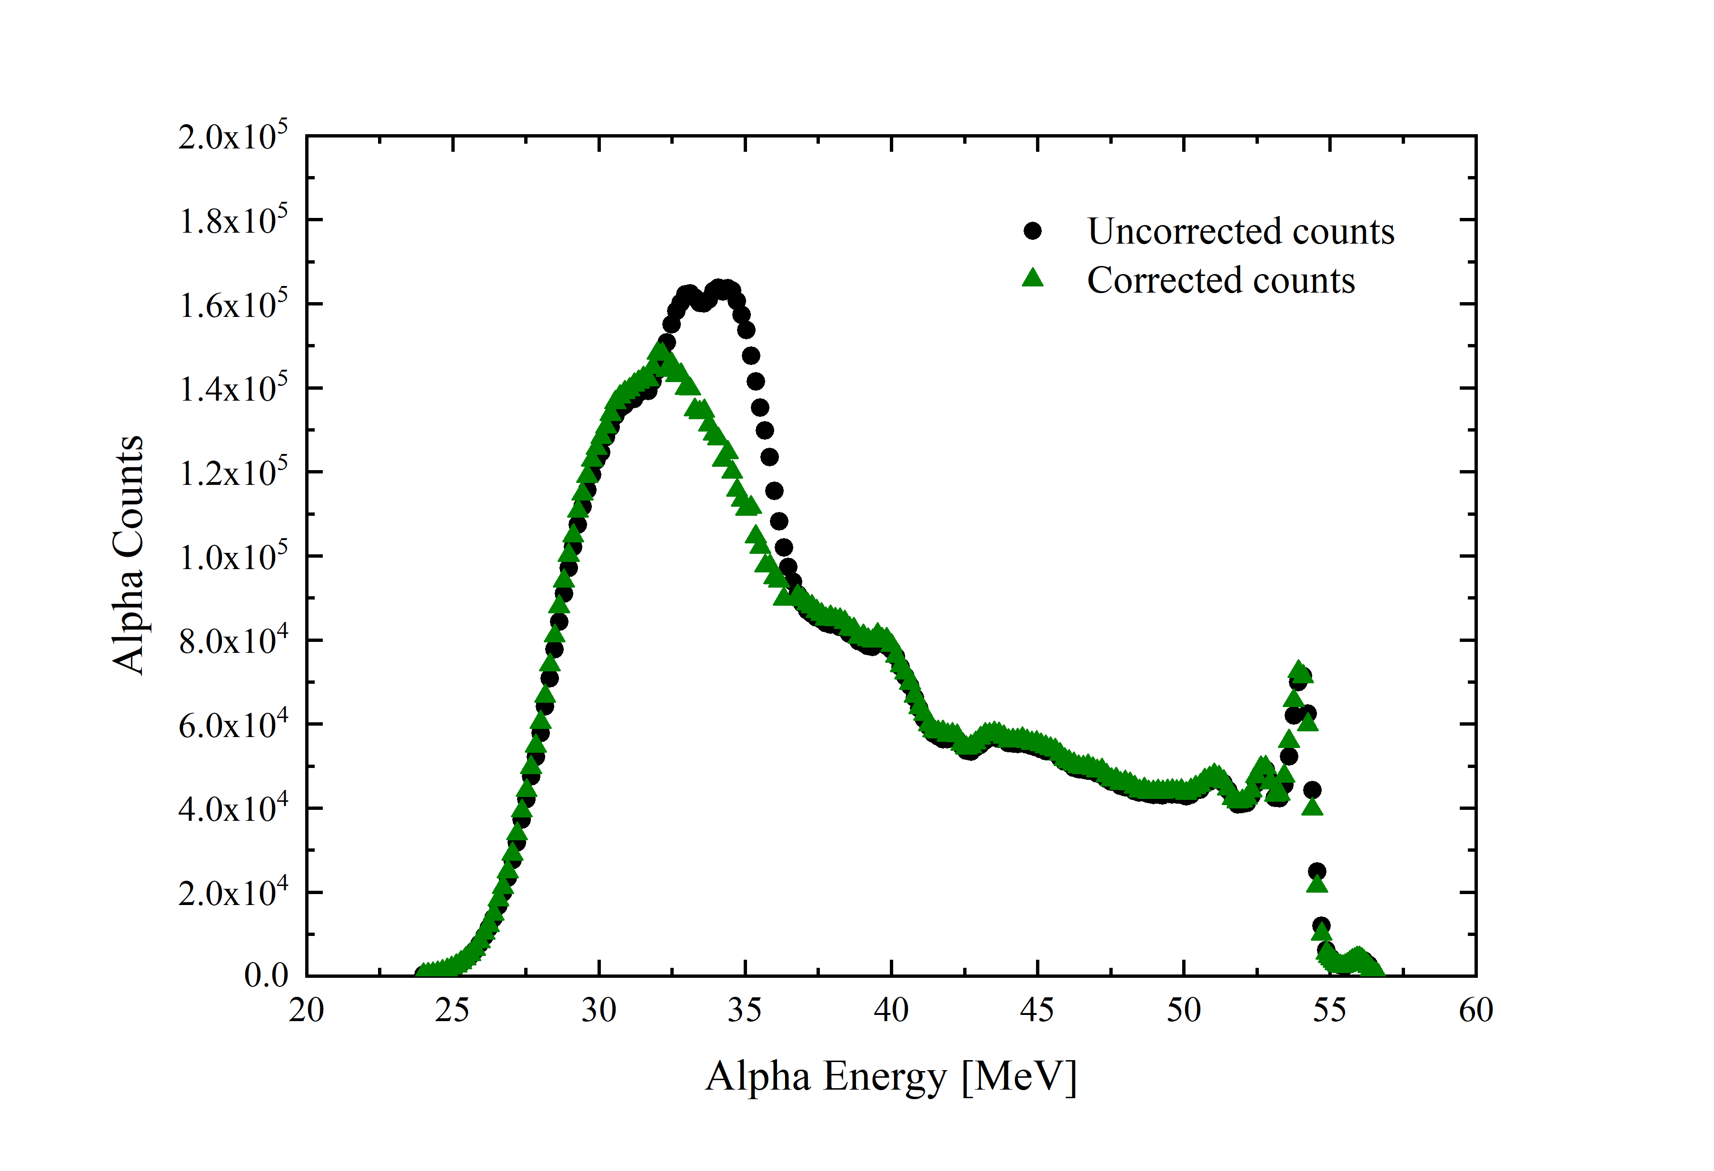
¹⁵⁵Gd(n,2n) cross section by measurement of surrogate reaction ¹⁵⁷Gd(³He,α2n)¹⁵⁴Gd
The alpha spectrum was corrected where there was contamination from carbon and oxygen reactions
The errors presented are statistical only – the full error analysis has not yet been done.
Plot with corrected counts
E. Matthews
A. Lewis
Notes:
To fill in the gap, tried to correct the alpha spectrum by comparing it to the alpha-gamma coincidence spectrum shape. But since this spectrum has the gamma efficiency tied up in it, can’t just use the numbers ,so only used the shape to “correct” the alpha spectrum.
The data points from the corrected alpha spectrum are given in green to make sure it is clear that they are different – will have different systematic uncertainty, and possibly a bias because of the correction.

Slide 24
FIER
___________________________

Slide 25
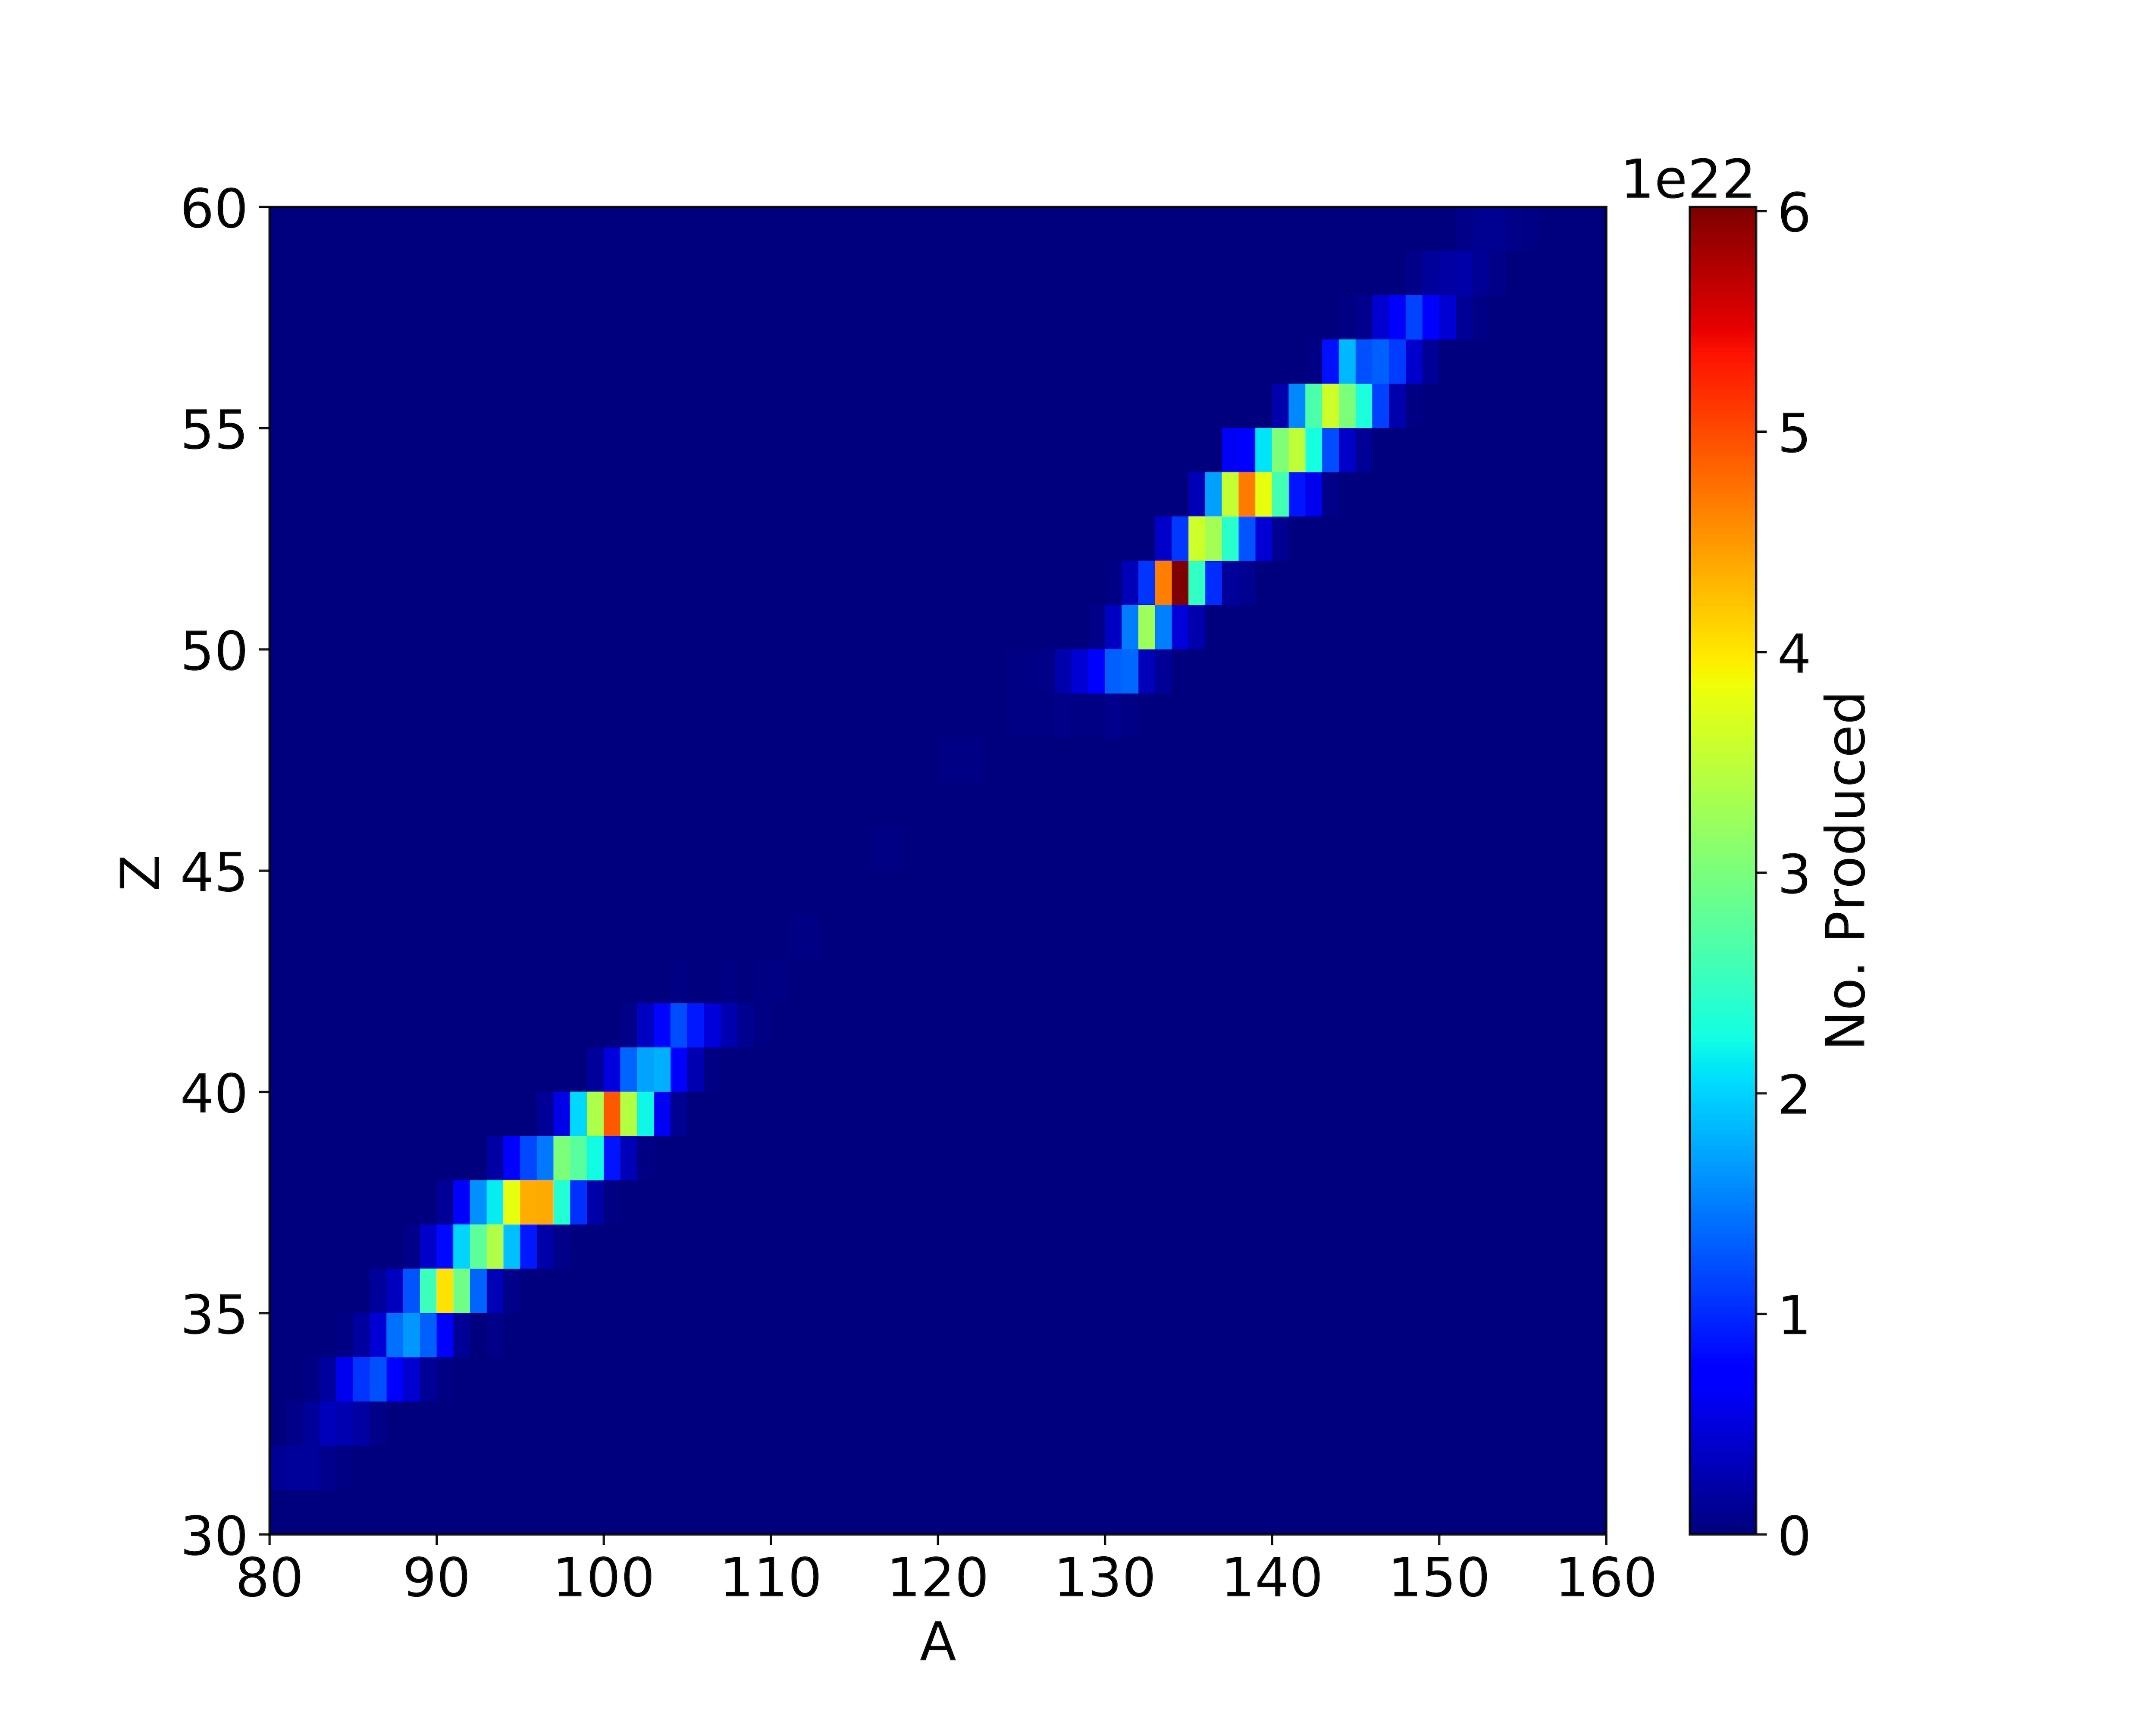

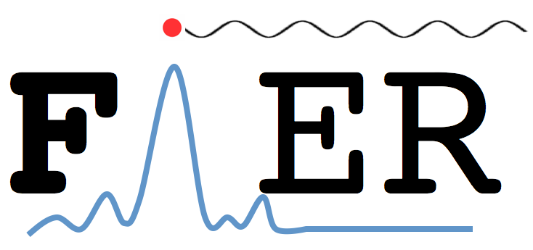
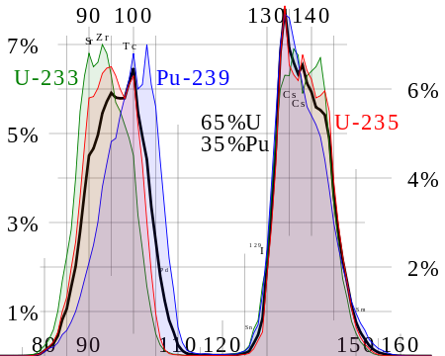
Input Data
INPUTS
Population Data
Decay/Structure
z
No. Produced
(ENDF File 8 / ENSDF)
Fission Yields
A
Gamma-Ray Spectra
E. Matthews
No. Emissions
Go see the poster!
(England and Rider)
Energy (keV)
Because FIER uses an analytical and exact model for production and decay of fission products, the accuracy of FIER outputs are only dependent on nuclear data. This makes FIER ideal for sensitivity studies.

Slide 26
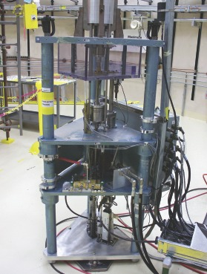

Integral Benchmarking with FIER
The experimental work presented shows how FIER is an integral calculation, making it ideal for use in integral benchmarking suites for nuclear data.
Fission yields and decay/structure data that are input to FIER should be tuned such that they reproduce high quality delayed gamma-ray data.
Experiment
Theory
Integral Benchmarks
Applications

Slide 27
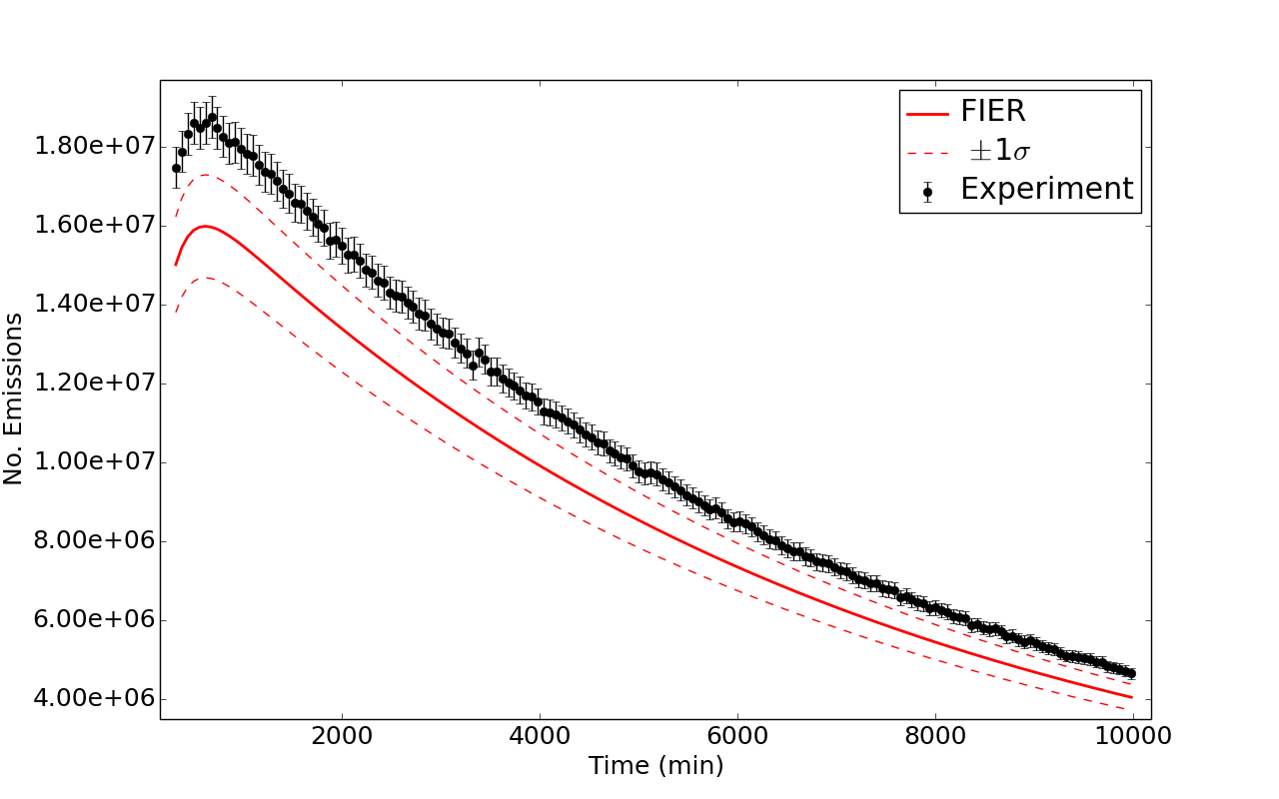
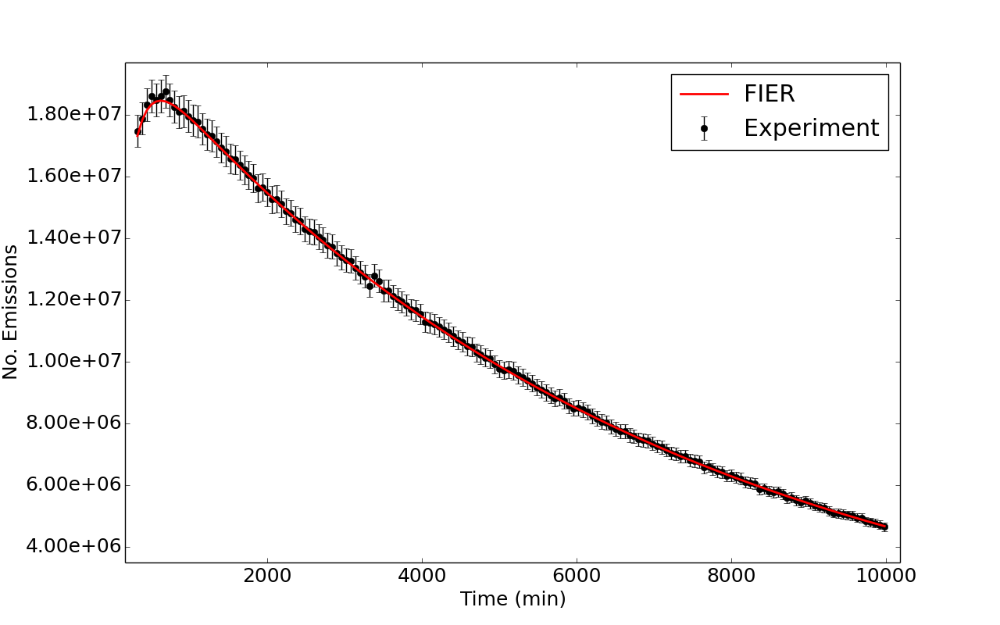
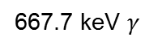
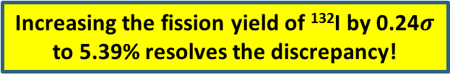
Case Study: Integral Benchmarking
…
¹³²Sb
2.79 m
¹³²Te cumulative yield
¹³²I cumulative yield
¹³²Te
3.204 d
¹³²Ba
~stable
¹³²I
2.295 h
¹³²Cs
6.480 d
Increasing the fission yield of ¹³²I by 0.24$σ$ to 5.39% resolves the discrepancy!
667.7 keV $γ$
667.7 keV $γ$
¹³²Xe
stable
The cumulative yield of ¹³²I has a large value at 4.67% with a relative uncertainty of 64%. Thus this fission yield is possibly the source of the magnitude offset between the gamma emission predicted by FIER and the experiment.
Demonstrates how FIER can be used to both investigate fission yield inaccuracies and provide improved values.
[1] Matthews et al. NIM-A 891 111-117. 2018.

Slide 28
Collaborators on this work
M.S. Basunia¹, J.A. Batchelder², T. Bates², J.D. Bauer³, T.A. Becker⁴, L.A. Bernstein^{1,2}, E.R. Birnbaum⁵, S. Chong², J.W. Engle^{5,6}, R.B. Firestone¹, S.A. Graves⁷, A.M. Hurst¹, T. Kawano⁵, L. Kirsch³, A.M. Lewis², E.F. Matthews², F.M. Nortier⁵, P.R. Renne⁴, D. Rutte⁴, A. Springer⁸, M.A. Unzueta², K.A. Van Bibber², A.S. Voyles², C.S. Waltz³, H. Zaneb⁹
¹ Lawrence Berkeley National Laboratory
² University of California-Berkeley Dept. of Nuclear Engineering
³ Lawrence Livermore National Laboratory
⁴ Berkeley Geochronology Center
⁵ Los Alamos National Laboratory
⁶ University of Wisconsin – Madison
⁷ University of Iowa – Department of Radiation Oncology
⁸ Karlsruhe Institute of Technology
⁹ University of Lahore

Slide 29

Tusen takk!

Slide 30
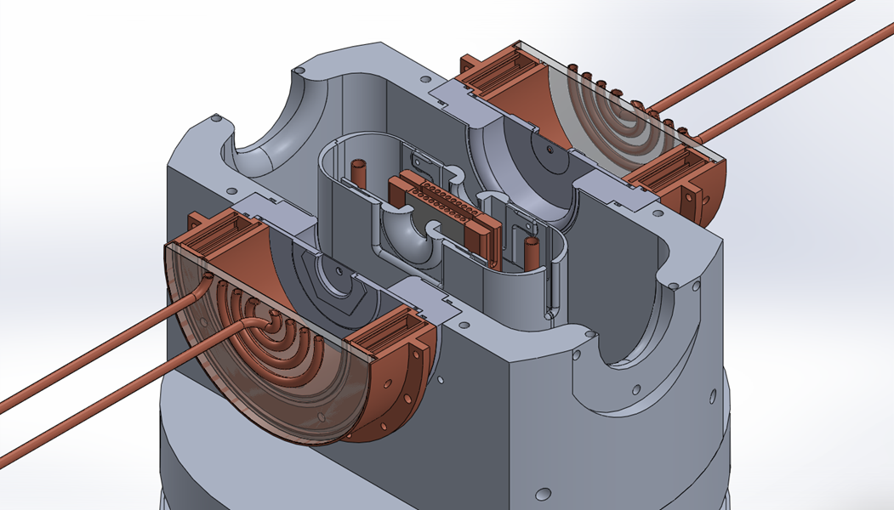
The UC Berkeley High Flux Neutron Generator
2.45 MeV neutrons, 10⁷ n/s/cm²
Extraction Plate: 5mm diameter
D Plasma
100kV
RF
DD Fusion
D beam
1-1000mA
Deuterium Gas
H₂O

Slide 31
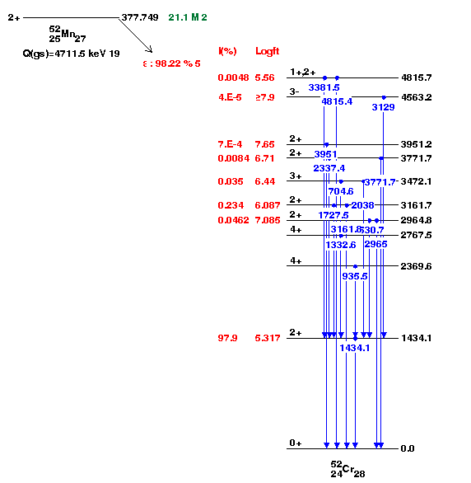
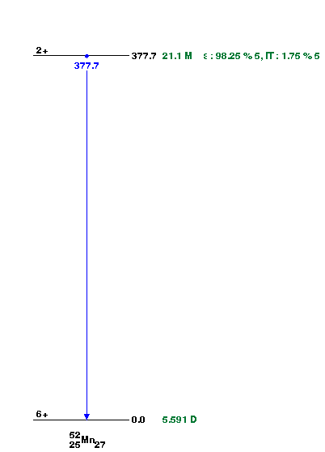

Slide 32
Input Data
Because FIER uses an analytical and exact model for production and decay of fission products, the accuracy of FIER outputs are only dependent on nuclear data. This makes FIER ideal for sensitivity studies.
Population Data
INPUTS
Fission Yields
Z
# Produced
Decay/Structure
A
(ENDF File 8 / ENSDF)
Gamma-Ray Spectra
(England and Rider)
# Emissions
Experiment
Theory
Integral Benchmarks
Energy (keV)
Applications

